Slide 1
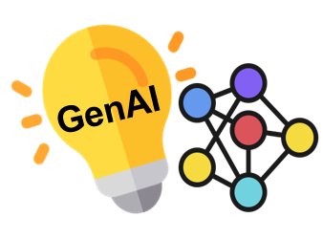




Tutorial 4
LLMs+Graphs: Toward Graph-Native, Synergistic AI Systems
Arijit Khan, Longxu Sun, Xin Huang
Bowling Green State University, USA
Hong Kong Baptist University, Hong Kong

Slide 2
Outlines
1. Introduction (Xin)
2. LLMs for Graphs (Xin)
3. Graphs for LLMs (Longxu)
4. KGs for LLMs (Arijit)
5. LLMs for KGs (Longxu)
6. Graphs for AI Agents (Arijit)
7. AI Agents for Graphs (Longxu)
8. Future Directions (Arijit)
Disclaimer: Some slides contain adapted material, and our discussion of related work is selective rather than comprehensive.

Slide 3
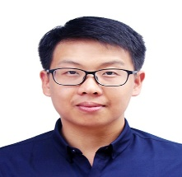
1. Introduction
  LLMs
  AI Agents
  Graph Foundation Models
  Retrieval-Augmented Generation
  Knowledge Graphs
Presented by Xin Huang

Slide 4

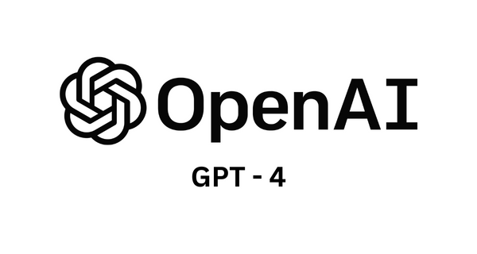


Large Language Models
Large Language Models are transformer-based neural networks trained on massive text corpora to learn patterns, structure, and meaning in language.
Large language models (LLMs) showcase strong generalization abilities to handle various NLP tasks, such as question answering and machine translation.
Key Capabilities
Text
Generation
Code
Generation
Question
Answering
Reasoning
Translation
Summarization
4

Slide 5
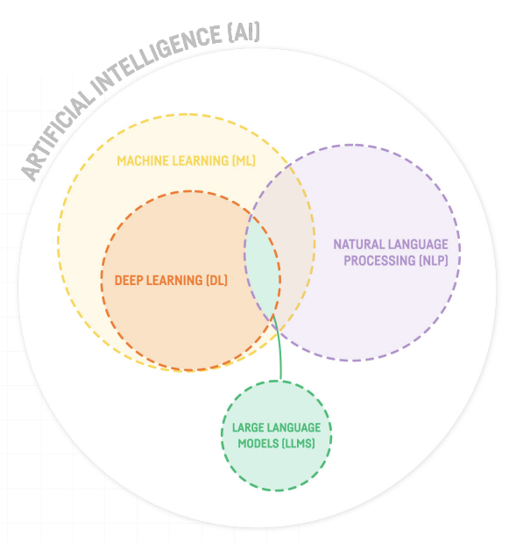




Scale matters: modern LLMs often contain billions of parameters and are trained on trillions of tokens.
NARROW
Notable Examples
https://blog.dataiku.com/large-language-model-chatgpt
5

Slide 6
The LLM Family Tree
From encoders to aligned multimodal systems — the progression reflects increasing scale, adaptability, and
task generality.
2018
1
BERT
Bidirectional encoder, masked language modeling
2
2019–2020
GPT-2/3
Autoregressive generation at scale
2022
3
InstructGPT / ChatGPT
RLHF alignment
4
2025–2026
GPT-4o / o3, Gemini 2.5, Claude 3.7, LLaMA 4, DeepSeek-V3
Reasoning-first models, long-context, agentic capabilities,
and open-weight frontier models
6

Slide 7

The Power & Limits of LLMs
Strengths
Semantic understanding, zero-shot generalization, natural language interfaces for data-intensive applications (Fernandez et al., VLDB 2023; Halevy et al., VLDB 2023)
Core Challenge
Hallucination Problem
Limitations in structured reasoning and multi-hop logic
Lack of grounding in verifiable facts or relational context — LLMs are mainly designed to process pure text, yet many real-world scenarios involve rich graph-structured information (Jin et al., TKDE 2024)
"While LLMs have shown pure text-based reasoning ability, it is underexplored whether such ability can
be generalized to graphs" (Jin et al., TKDE 2024)
7

Slide 8

AI Agents
AI Agent is an autonomous software entity that perceives its environment, makes decisions, and acts to achieve specific goals.
AI agents can interact with users, other agents, or systems.
Examples:
  Virtual Personal Assistants: Siri, Alexa, Google Assistant, Open Claw
  Autonomous Vehicles: Waymo, Tesla’s Autopilot
  Game Non-Player Characters (NPCs): Chess AI (Stockfish)
8

Slide 9
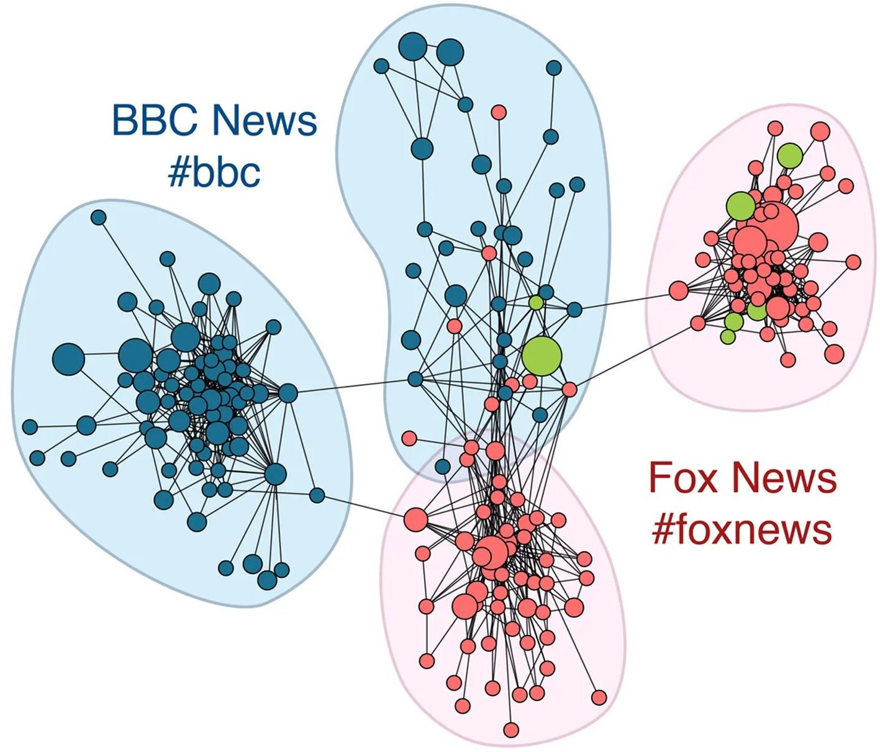
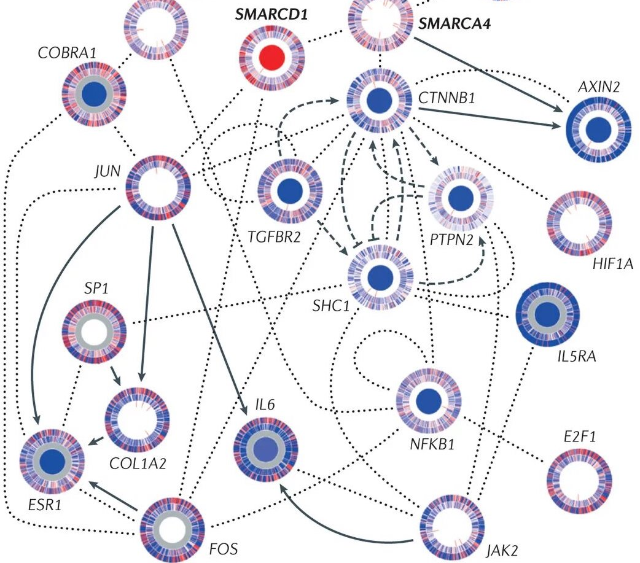
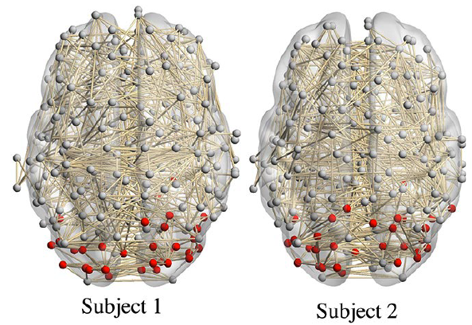
Graph
Graph G(V, E) is a mathematical model to describe various entities V and their relations E.
Graph can be explained as a general language to describe entities’ connections and interactions in nature and society.
Protein-Protein Network
Brain Network
[Luo et al. KDD 2020]
Follower Network
[Nature 2013]
[Nature 2013]
9

Slide 10
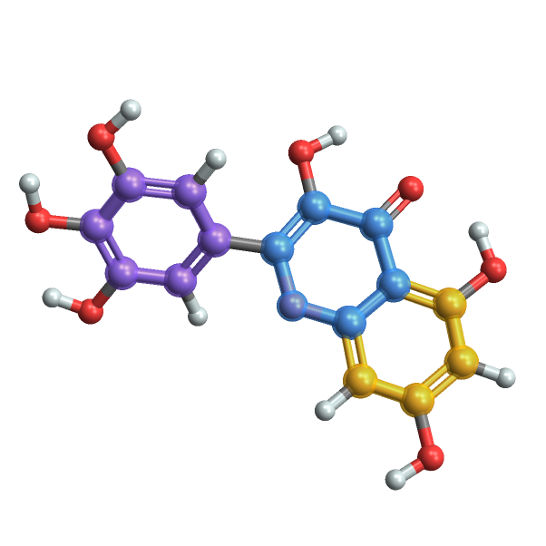
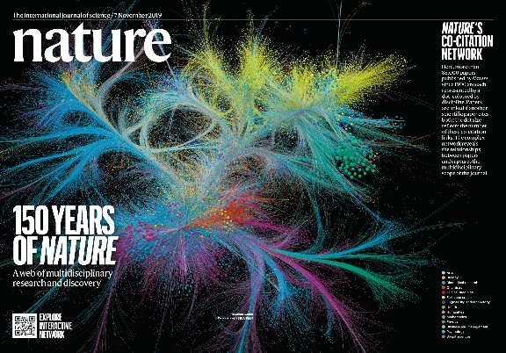
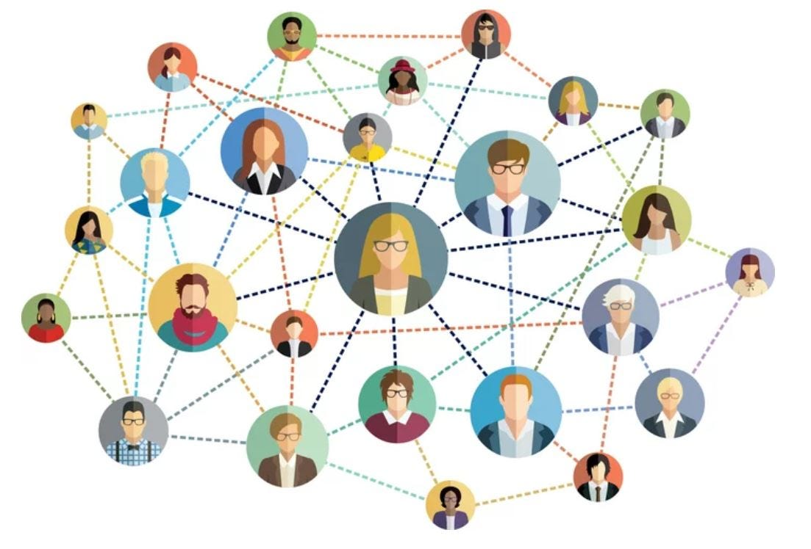
Text-attributed Graphs
Text-attributed graphs with raw and detailed text attributes, capturing rich and comprehensive semantics.
Citation networks
Social networks
Molecular graphs
10

Slide 11
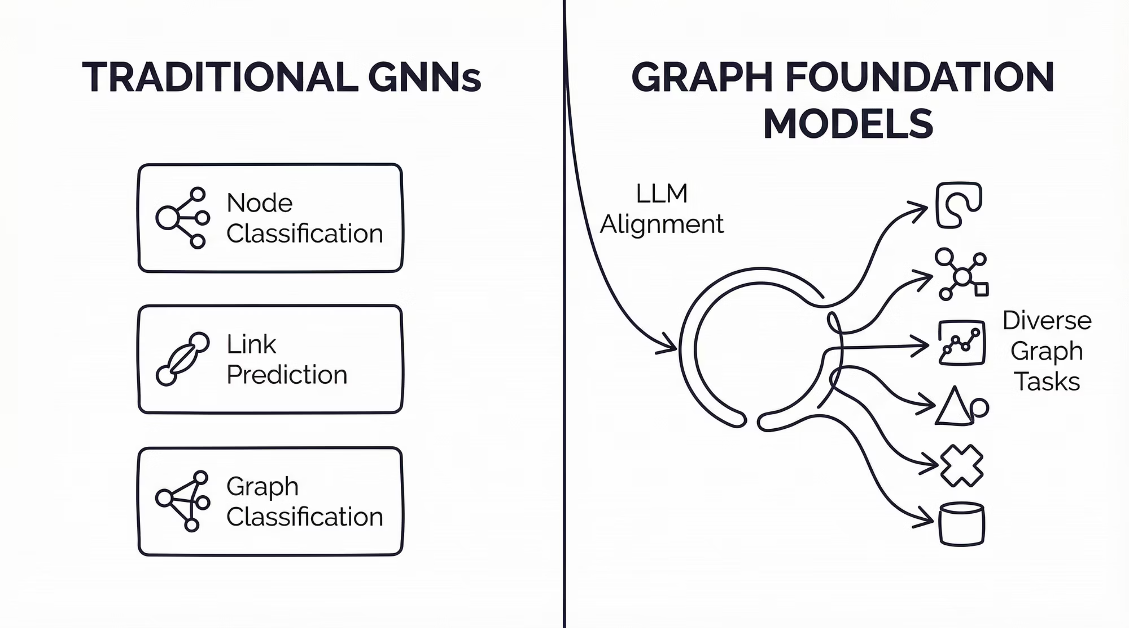
Graph Foundation Models
A foundation model is a model trained on broad data that can be adapted to a wide range of downstream tasks
Mao, H., et al. “Position: Graph Foundation Models Are Already Here.” ICML. (2024)
11

Slide 12
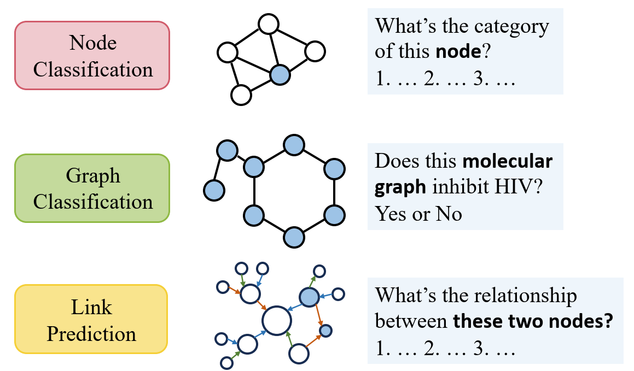
Goal: Train one graph foundation model for all classification tasks
12

Slide 13
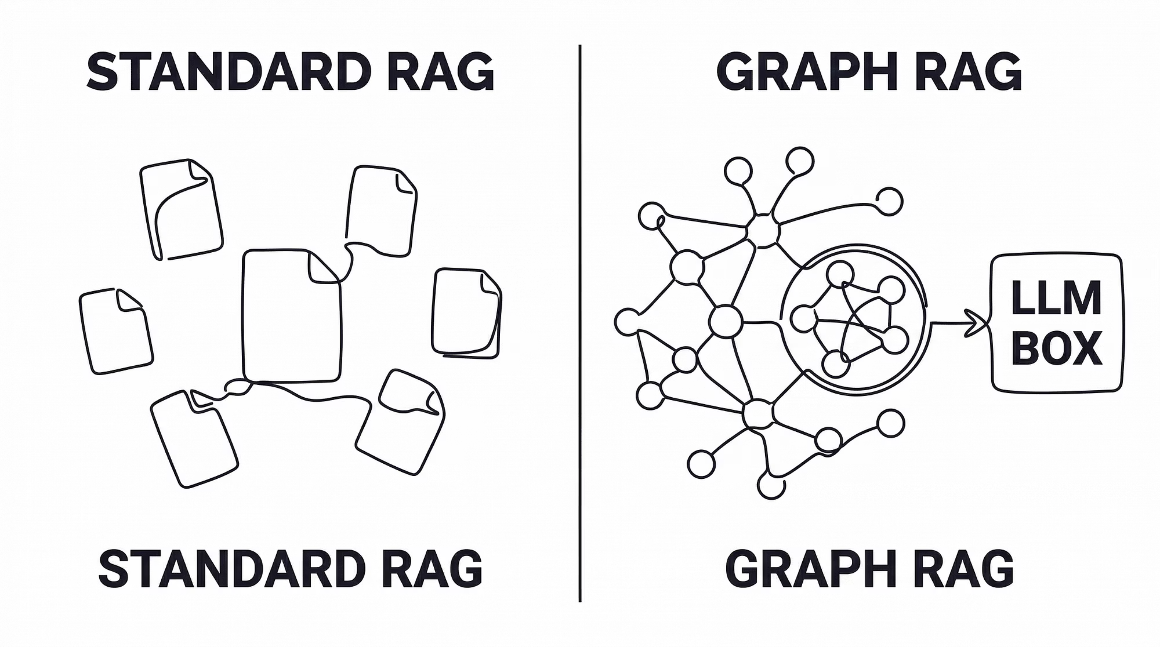
Retrieval-Augmented Generation
RAGs can enhance the capabilities of LLMs by integrating them with search or retrieval systems.
  Access up-to-date knowledge and external data source
Examples:
  Microsoft Bing Chat
  GitHub Copliot
  Medical Question Answering
13

Slide 14
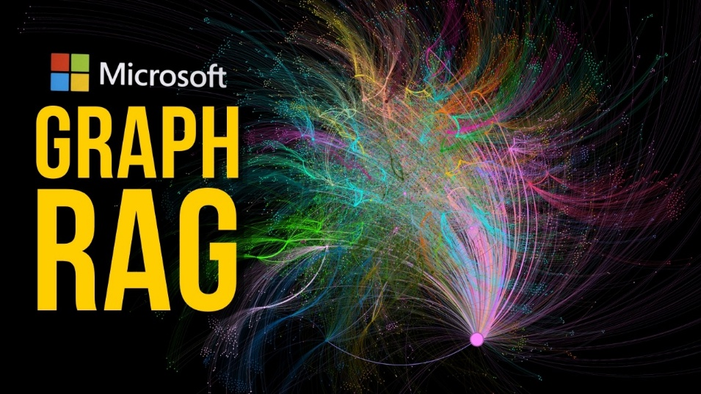
Microsoft GraphRAG
  Key idea: convert documents into a knowledge graph and then retrieve the relevant document communities
  Phases:
    Builds entity-relation graph from documents
    Detects communities via Leiden algorithm
    Generates community-level summaries for global QA
14

Slide 15
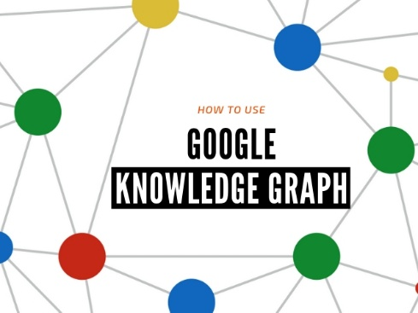
Knowledge Graphs
A knowledge graph keeps a structured network of entities (such as people, places, or things) and their fact/relationships.
Knowledge graphs enable LLMs, AI Agents, and machines to understand and utilize the complex interconnected information.
Examples:
  Google Knowledge Graph
  Wikidata
  Amazon Product Graph
  Biomedical Graphs for Drug Discovery
15

Slide 16
2. LLMs for Graphs
  A. Graph Understanding
    Graph Computation
  B. Graph Learning
    LLMs-as-generators
    Unsupervised Graph Representation
    Graph Diffusion Prediction
  C. Graph Foundational Models
Presented by Xin Huang

Slide 17
A Survey on LLM-based Generative Graph Analytics
Wenbo Shang, Xin Huang. A survey of large language models on generative graph analytics: Query, learning, and applications. IEEE TKDE 2025.
17

Slide 18
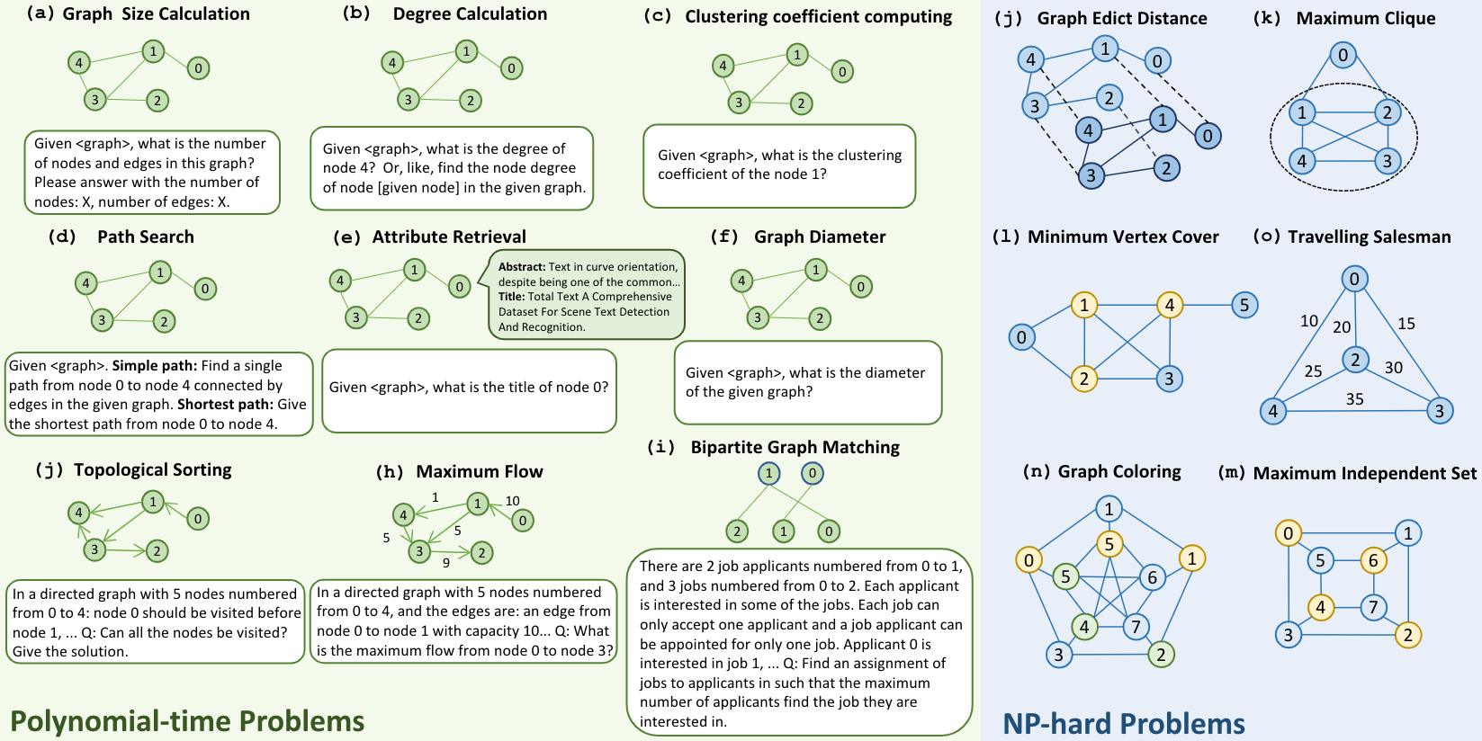
Graph Structure Understanding
18

Slide 19
Graph Structure Understanding
19

Slide 20
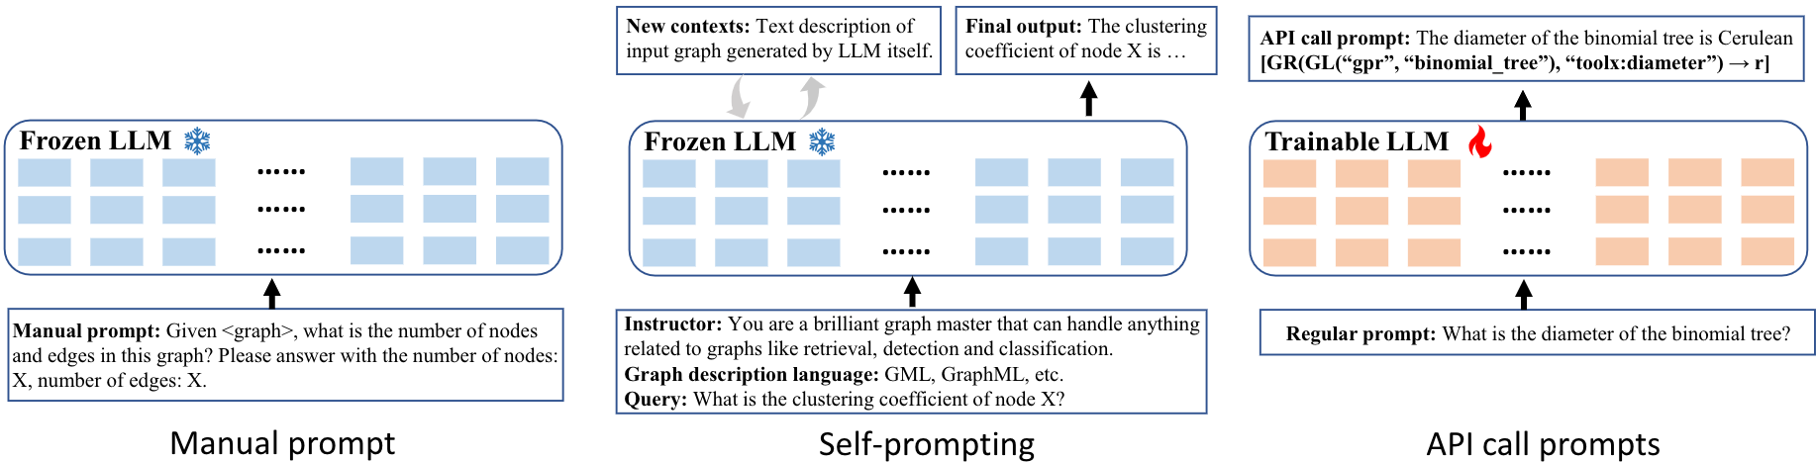
Graph Structure Understanding Methods
20

Slide 21
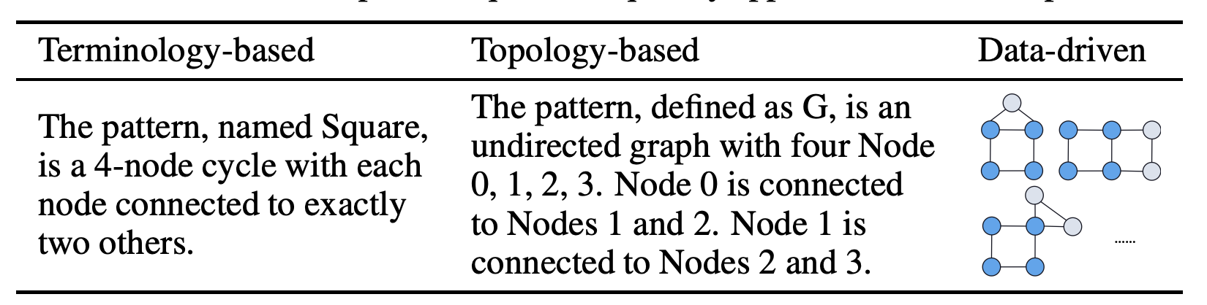
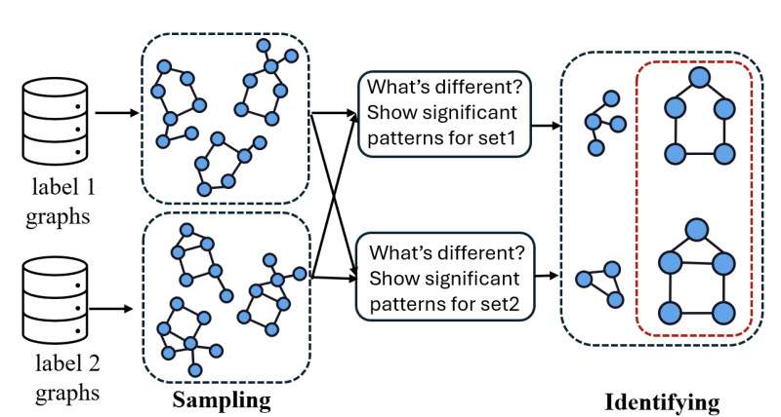
Graph Pattern Comprehension
[1] How Do Large Language Models Understand Graph Patterns? A Benchmark for Graph Pattern Comprehension [ICLR’25]
21

Slide 22
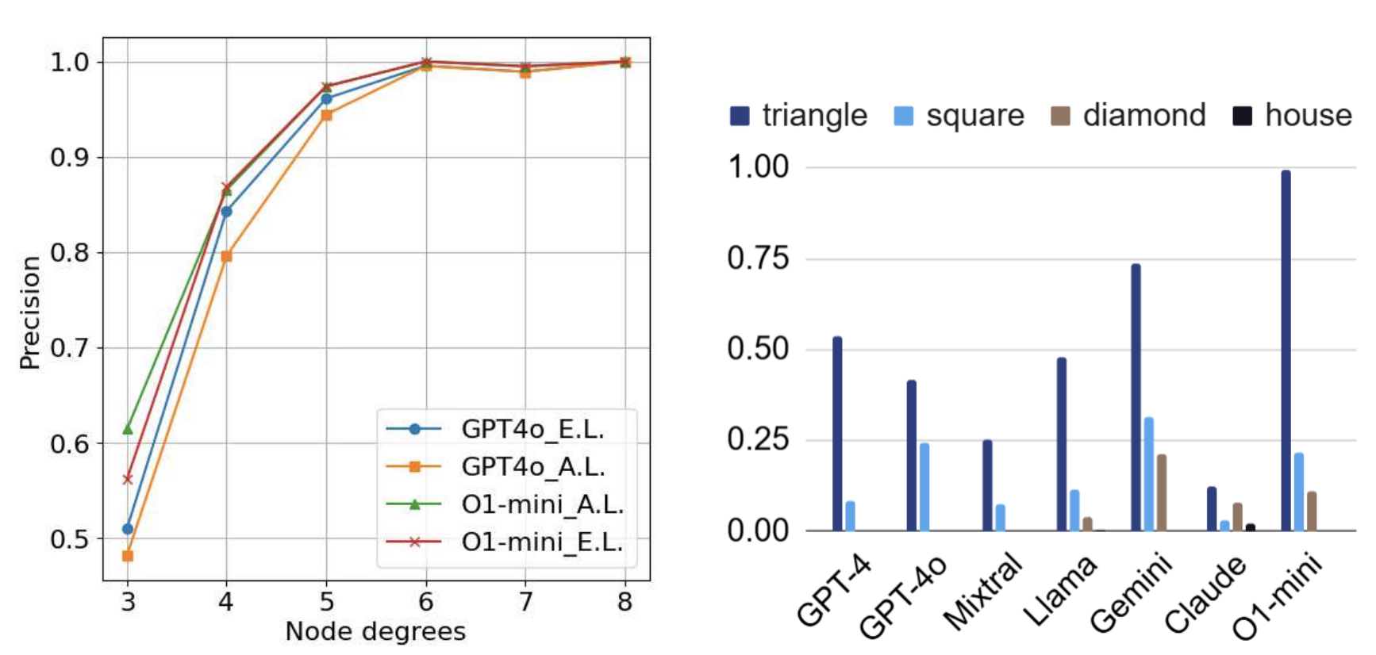
Graph Pattern Comprehension
[1] How Do Large Language Models Understand Graph Patterns? A Benchmark for Graph Pattern Comprehension [ICLR’25]
22

Slide 23
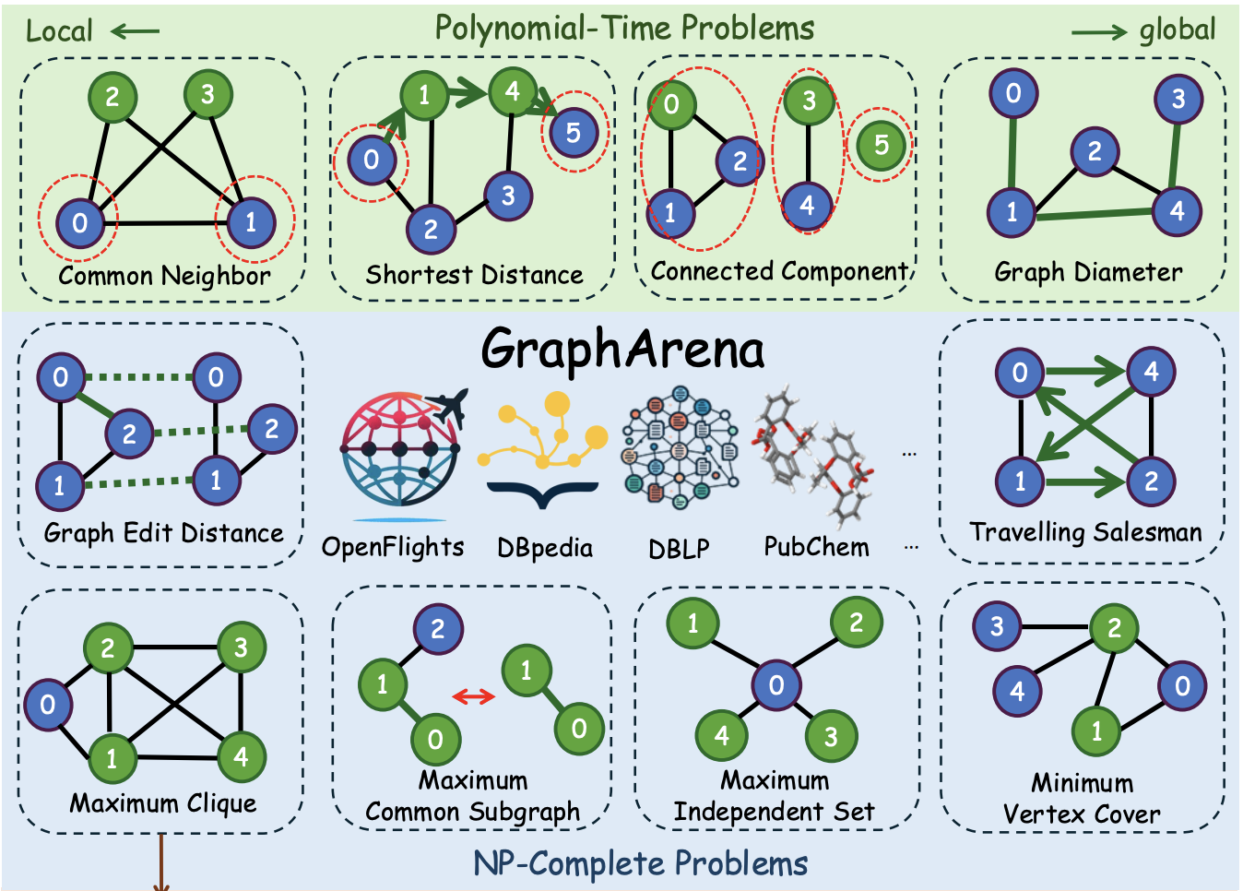
LLM on Graph Computational Problems
[1] GraphArena: Evaluating and Exploring Large Language Models on Graph Computation [ICLR’25]
23

Slide 24
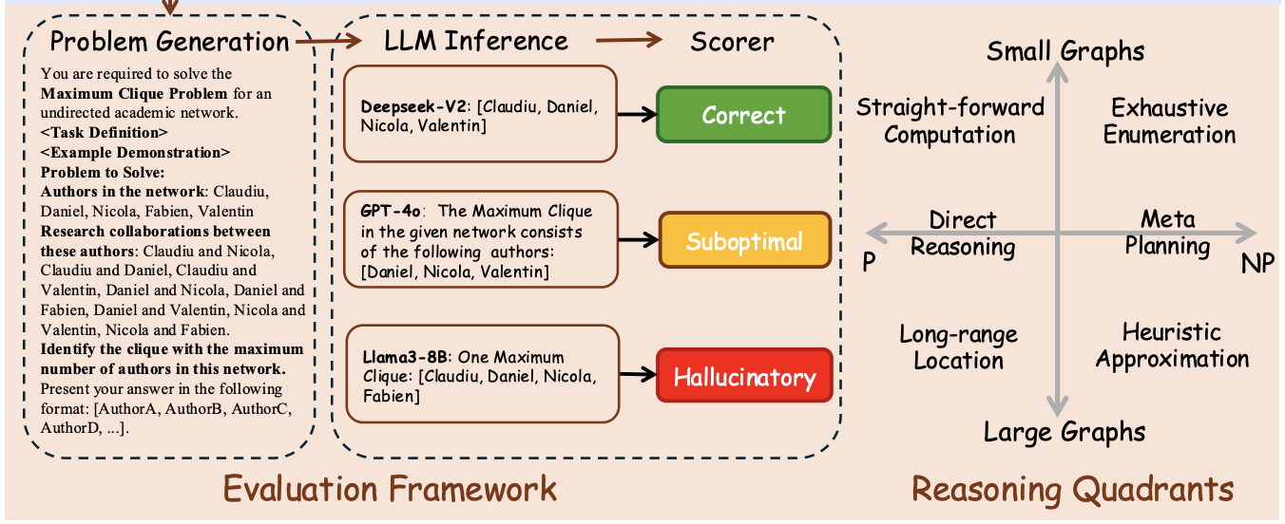
LLM on Graph Computational Problems
[1] GraphArena: Evaluating and Exploring Large Language Models on Graph Computation [ICLR’25]
24

Slide 25
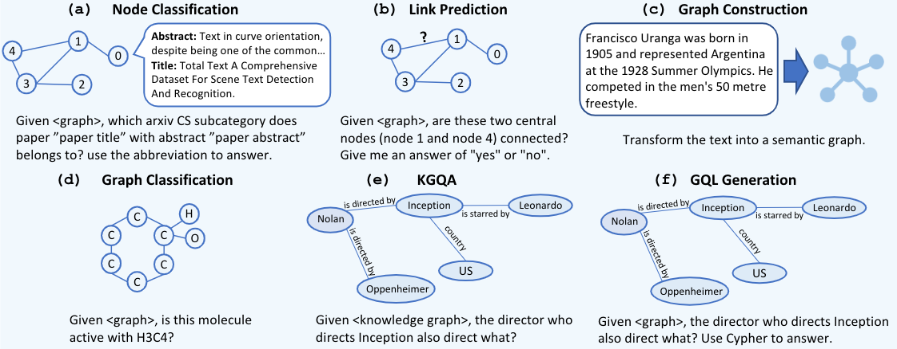
Graph Learning
25

Slide 26
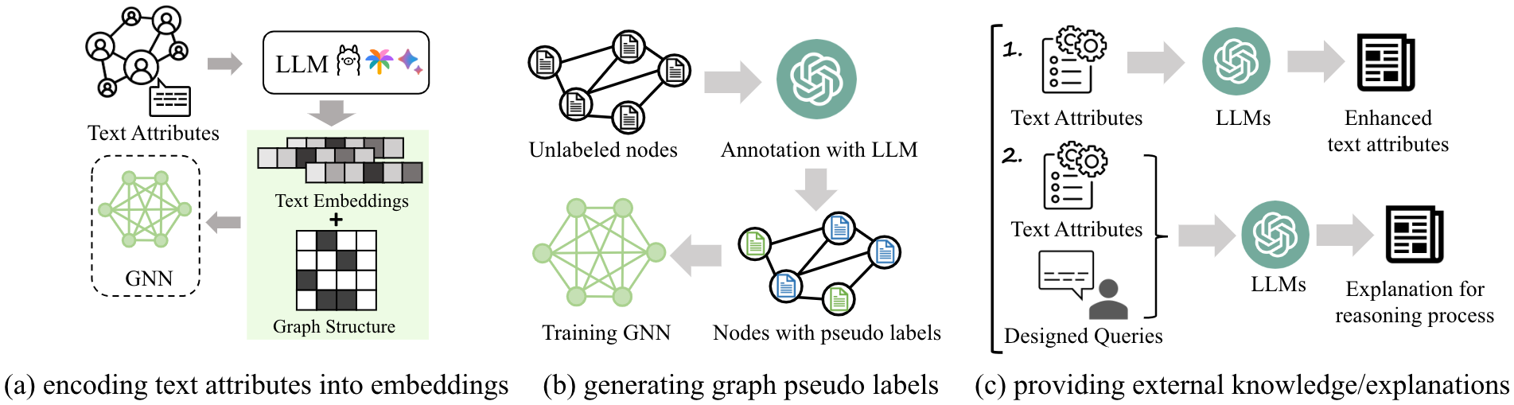
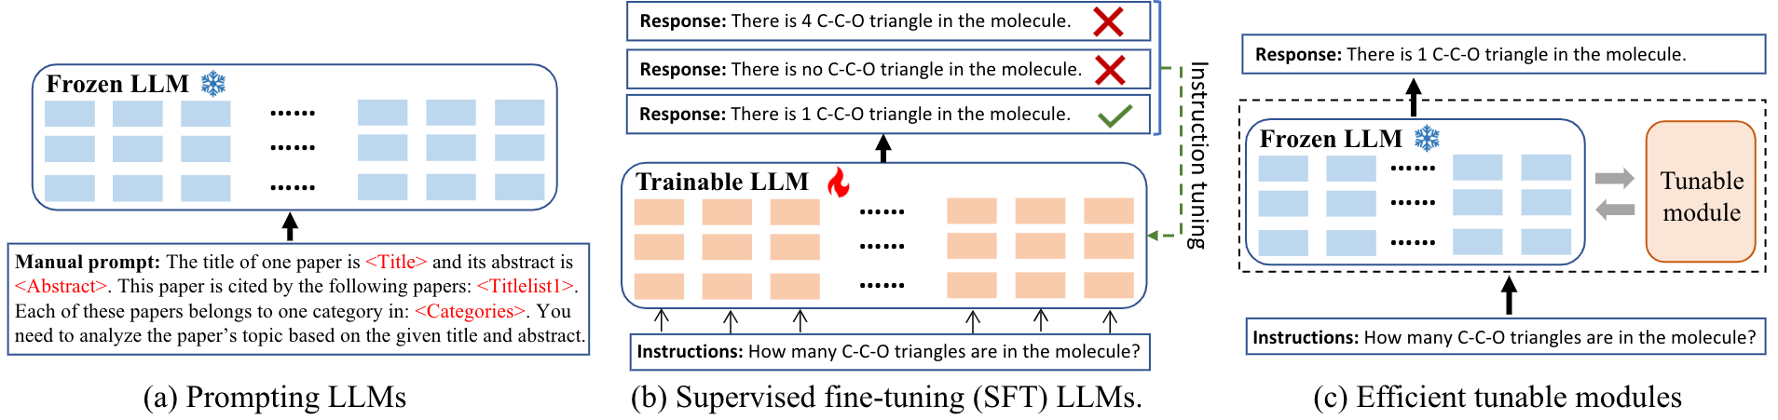
Graph Learning
LLMs-as-enhancers
LLMs-as-predictors
26

Slide 27
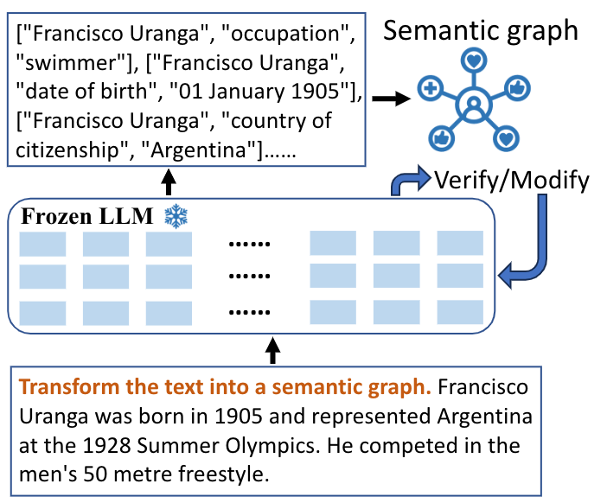
Graph Learning
LLMs-as-generators
27

Slide 28
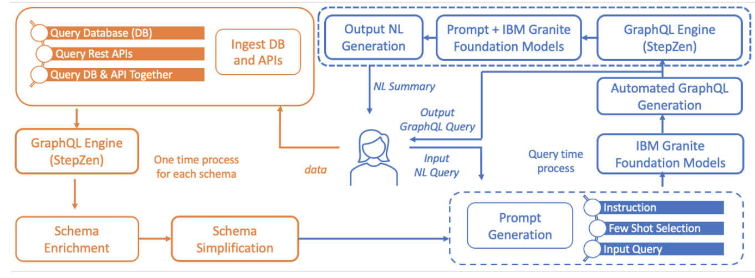
LLM-powered GraphQL Generator
[1] LLM-powered GraphQL Generator for Data Retrieval [IJCAI’24]
28

Slide 29
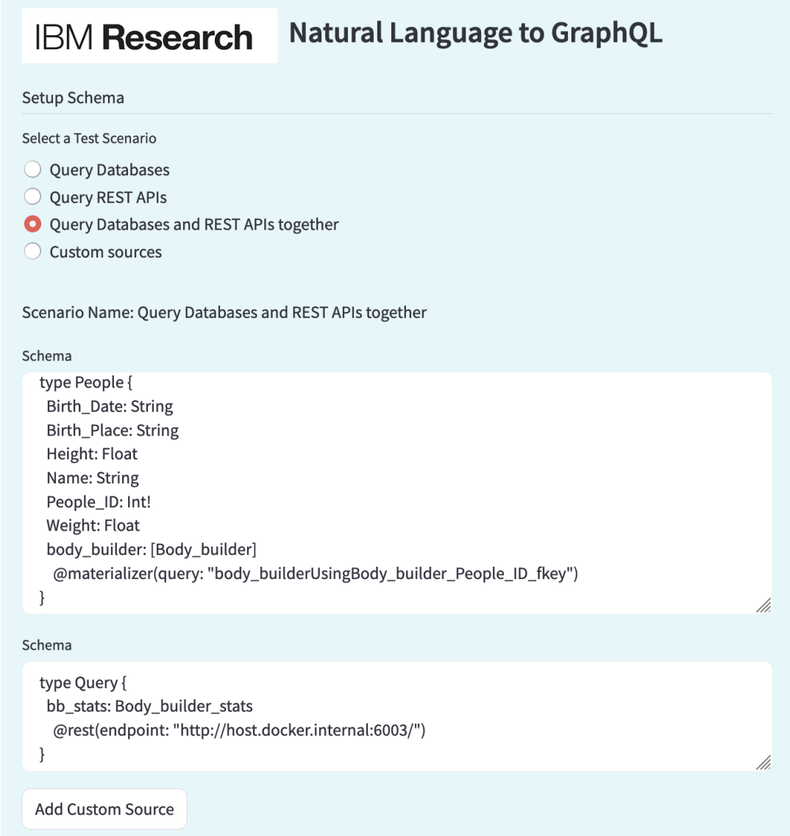
LLM-powered GraphQL Generator
[1] LLM-powered GraphQL Generator for Data Retrieval [IJCAI’24]
29

Slide 30
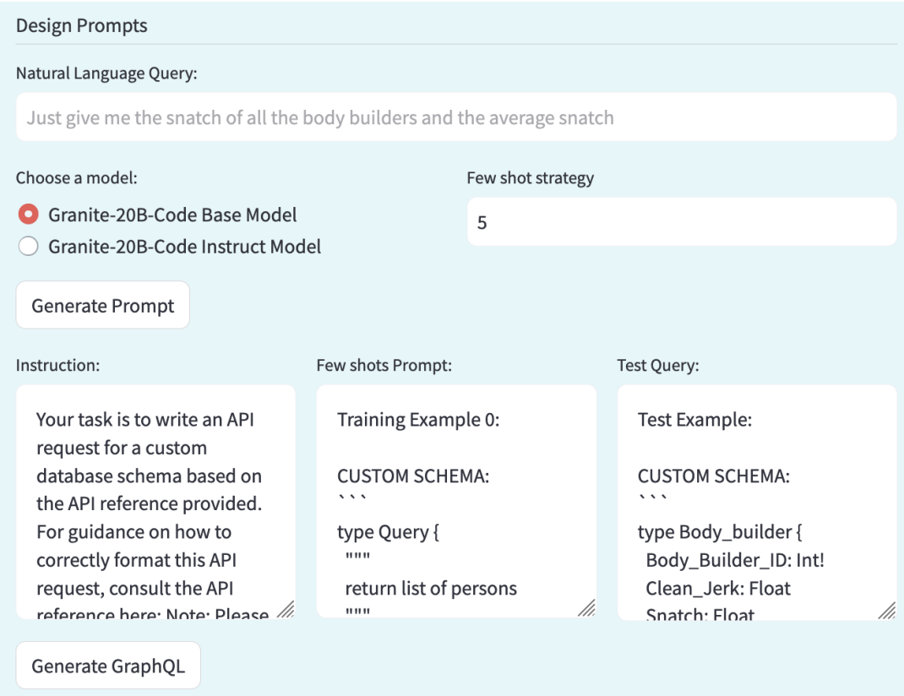
LLM-powered GraphQL Generator
[1] LLM-powered GraphQL Generator for Data Retrieval [IJCAI’24]
30

Slide 31
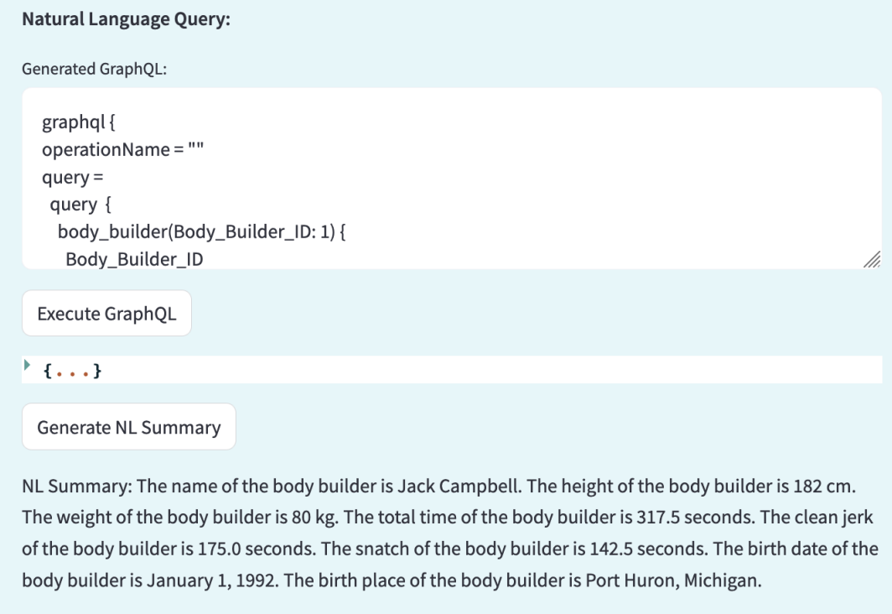
LLM-powered GraphQL Generator
[1] LLM-powered GraphQL Generator for Data Retrieval [IJCAI’24]
31

Slide 32
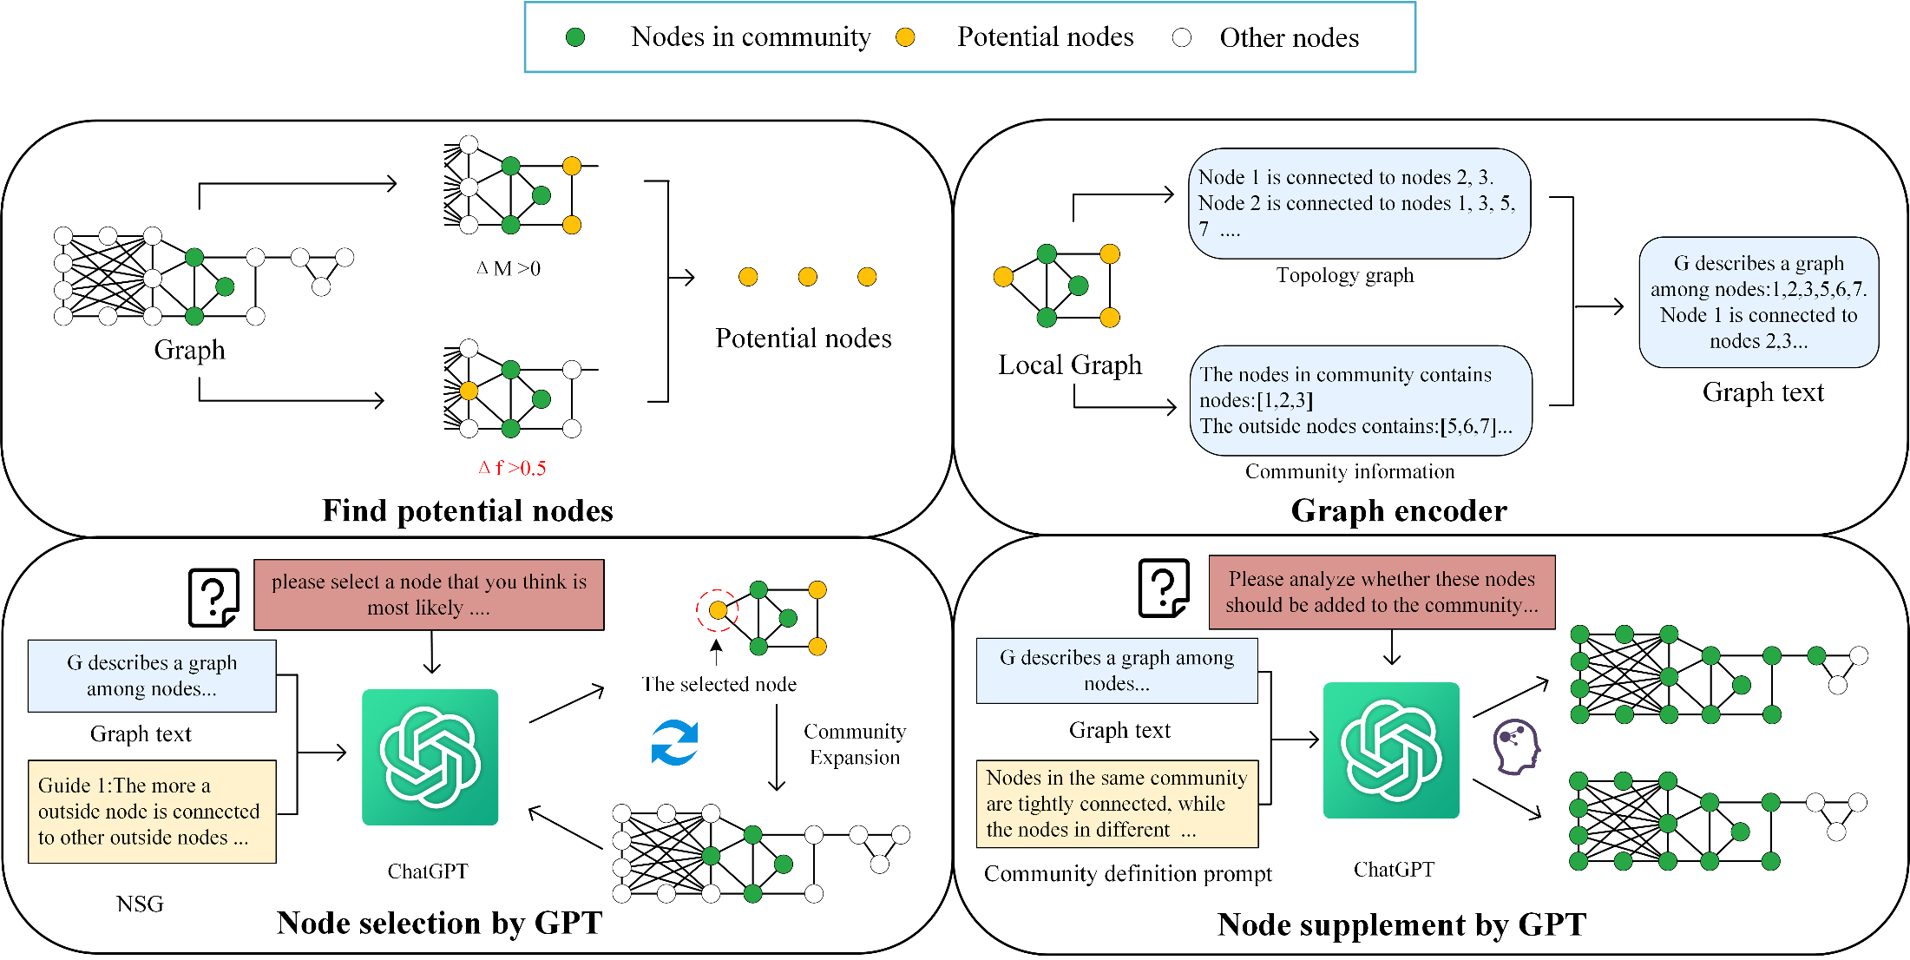
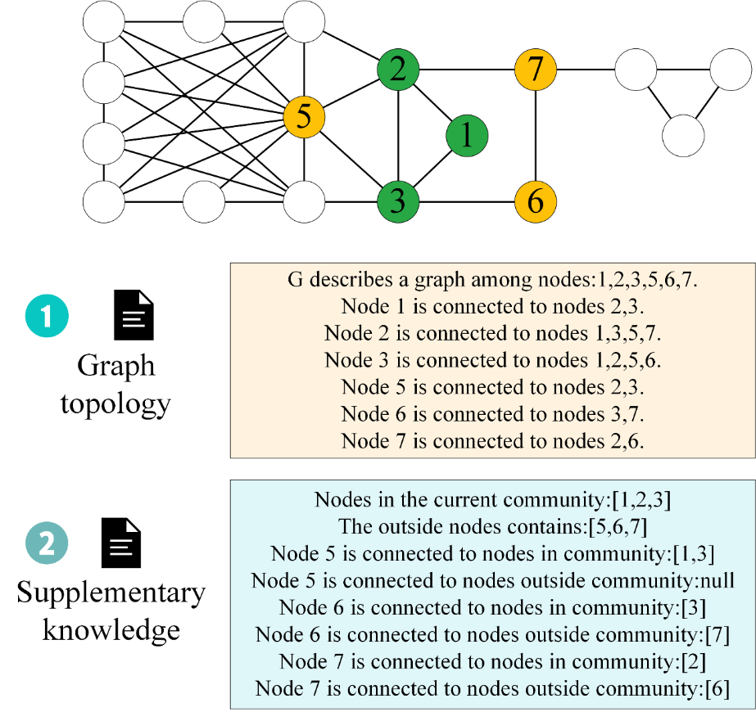
ComGPT: Detecting Local Community Structure with LLMs
[1] ComGPT: Detecting Local Community Structure with Large Language Models [TCSS’26]
32

Slide 33
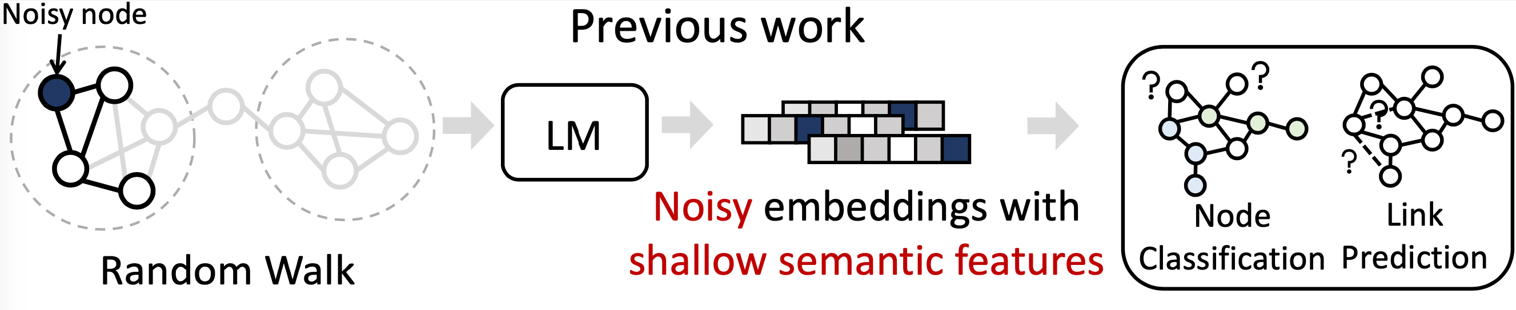
WalkLM
Random walks can hardly cover the bridge edges between different dense groups.
Random walks can easily involve noisy nodes to damage the embedding quality. Meanwhile, the node texts of irregular paths cannot match the linguistic rules, bringing more difficulty for learning models.
The transferability of WalkLM to LLMs with causal language modeling is limited, as it is primarily designed for relatively small LMs with masked language modeling
33

Slide 34
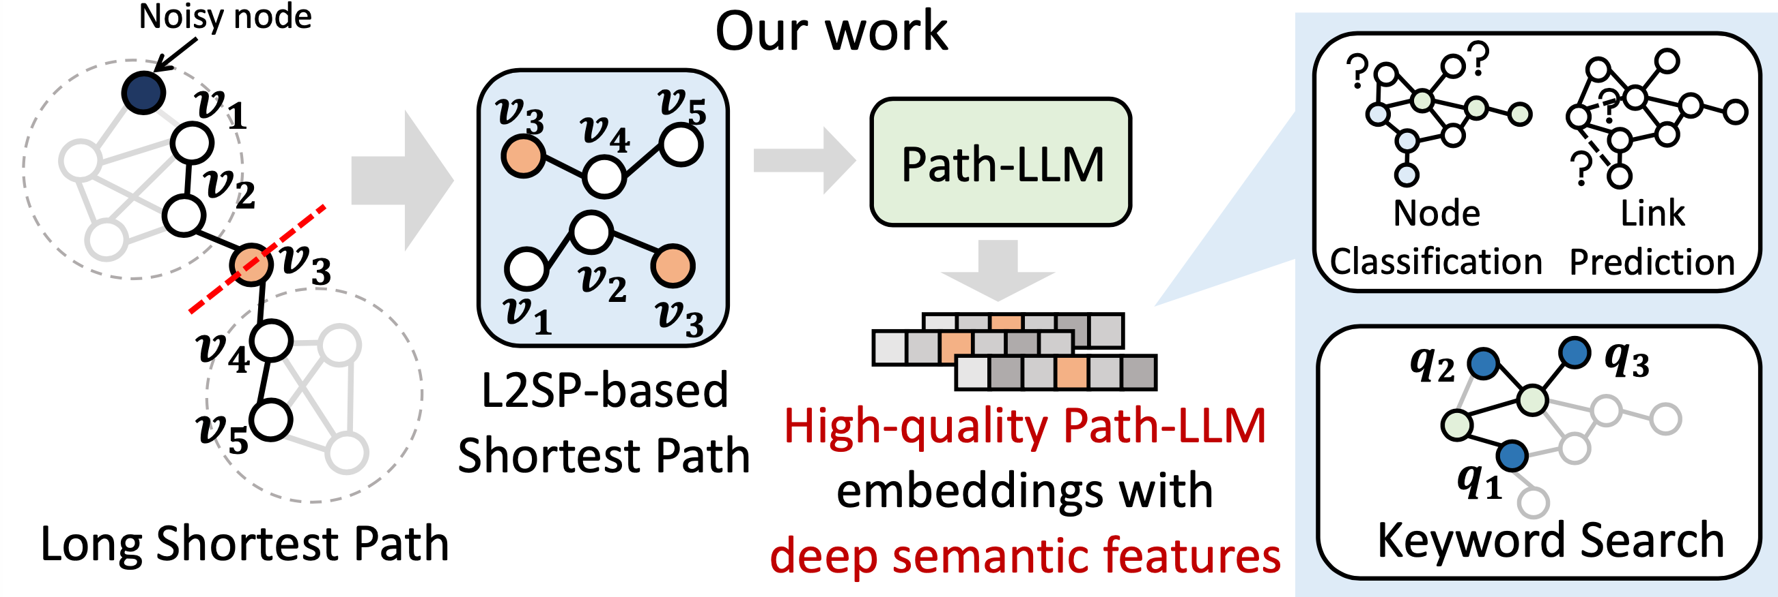
Path-LLM
Leverage graph structures, graph information, and representation capabilities of a large language model to derive unified graph embeddings for graph learning tasks and one NP-hard task, keyword search.
Shang et al.. 2024. Path-LLM: A Shortest-Path-based LLM Learning for Unified Graph Representation
34

Slide 35
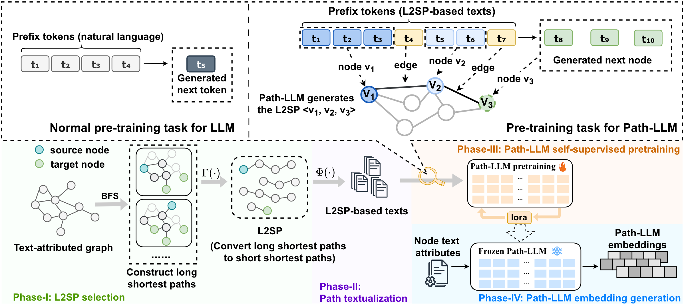
Path-LLM Framework
35

Slide 36
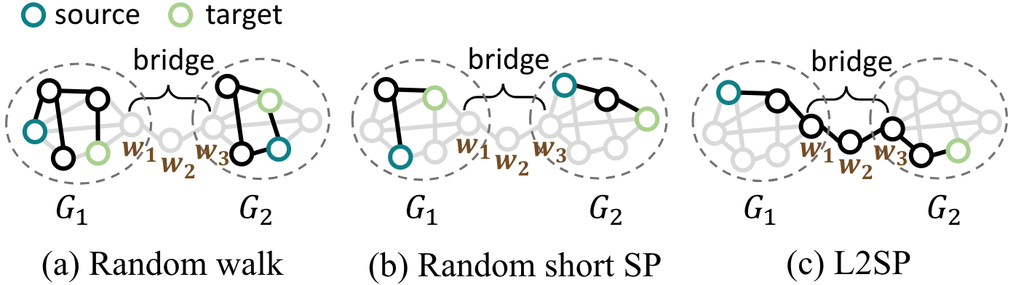
L2SP Selection
Three path sampling for a comparison
36

Slide 37
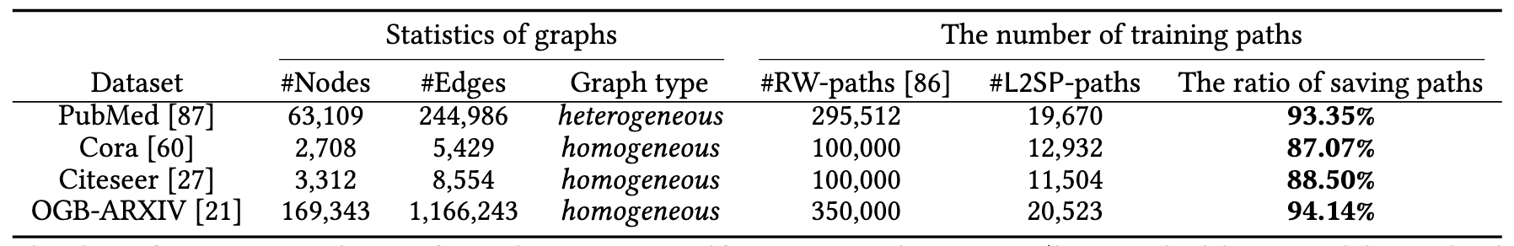
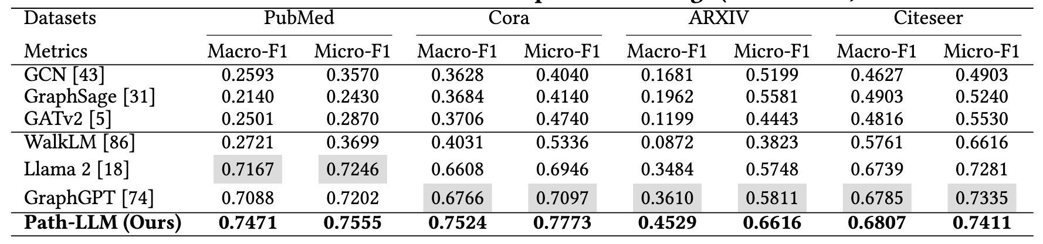
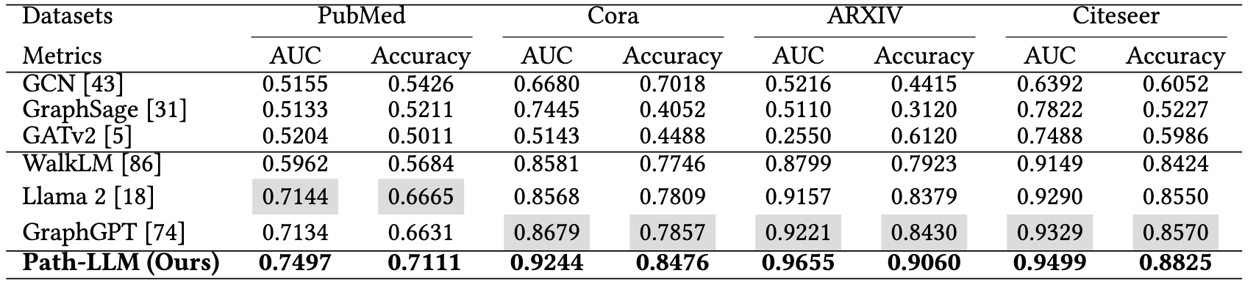
Experiments
37

Slide 38
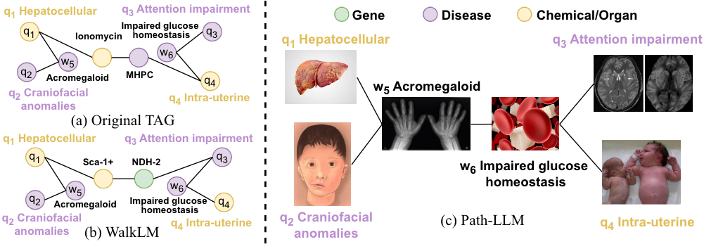
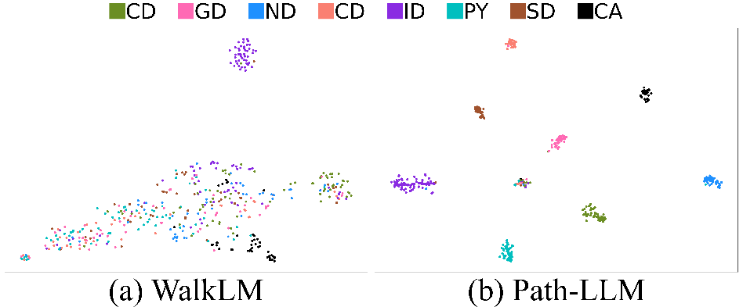
Case Study: Keyword Search
38

Slide 39

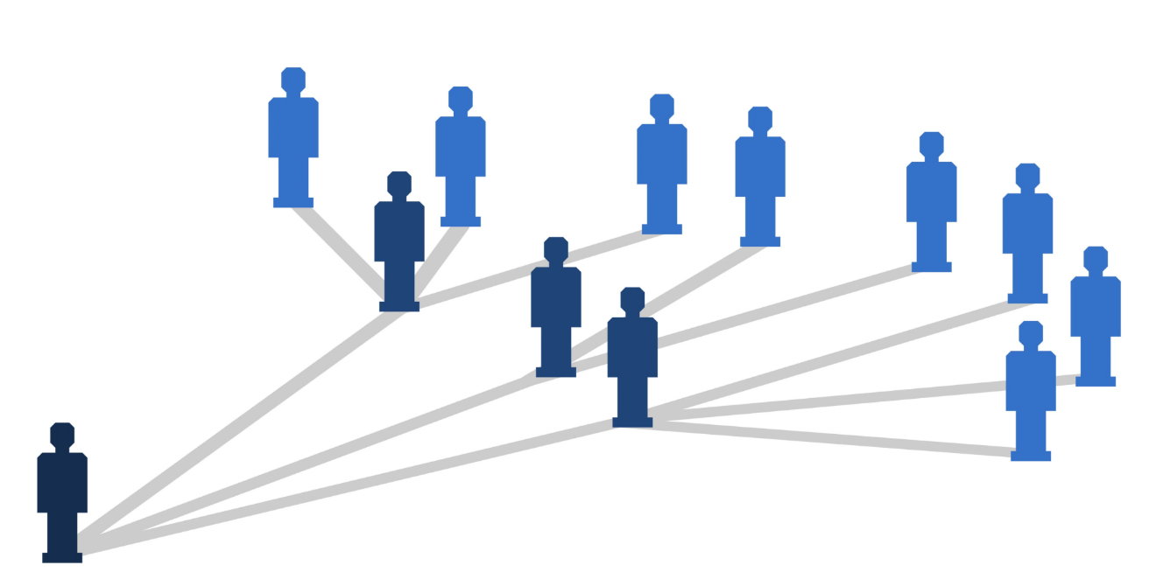


Information Diffusion Cascade
Many social platforms allow users to post various content and communicate on topics of mutual interest, facilitating the fast diffusion of information and form information cascades.
Diffusion prediction aims to predict the potential users who will be infected based on the observed diffusion cascades.
?
39

Slide 40
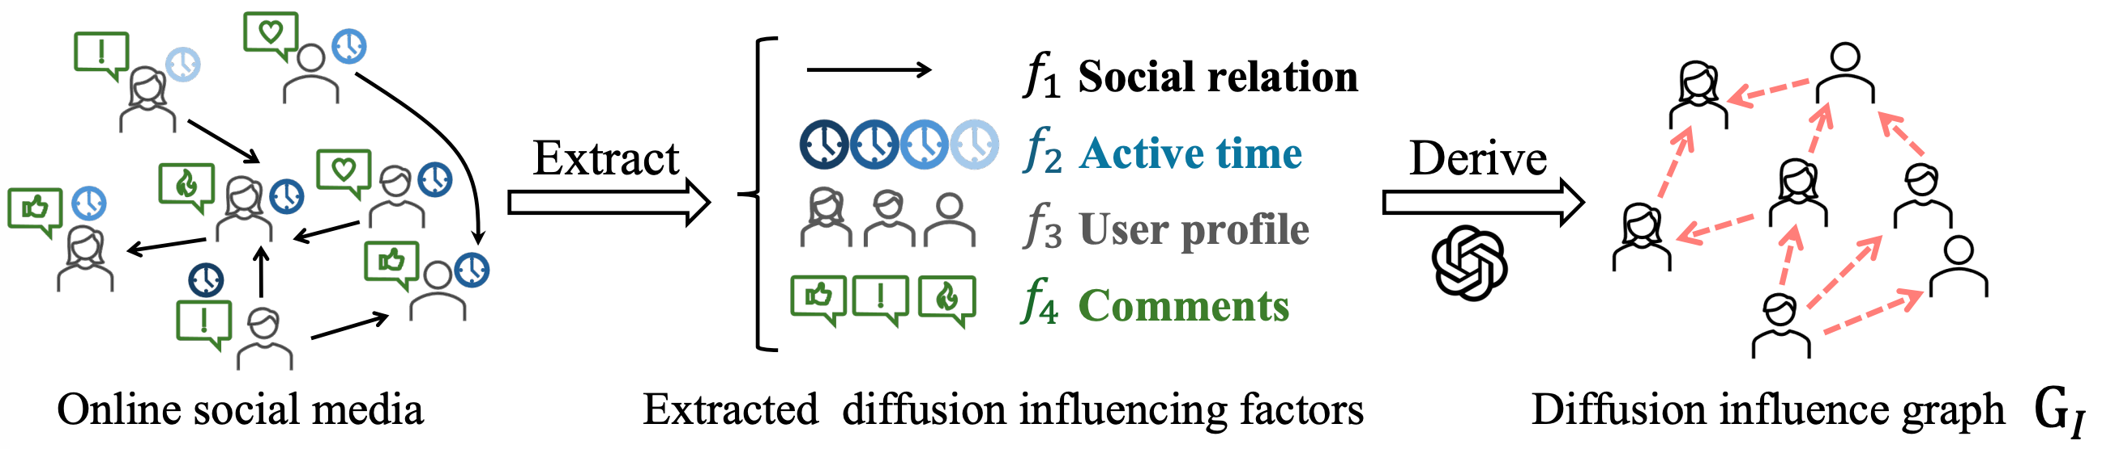
Motivation
As the authentic diffusion process is unknown, unexplainable, and non-transparent, constructing Z becomes challenging.
40
Shang et al. Make Information Diffusion Explainable: LLM-based Causal Framework for Diffusion Prediction. NeurIPS 2025.

Slide 41
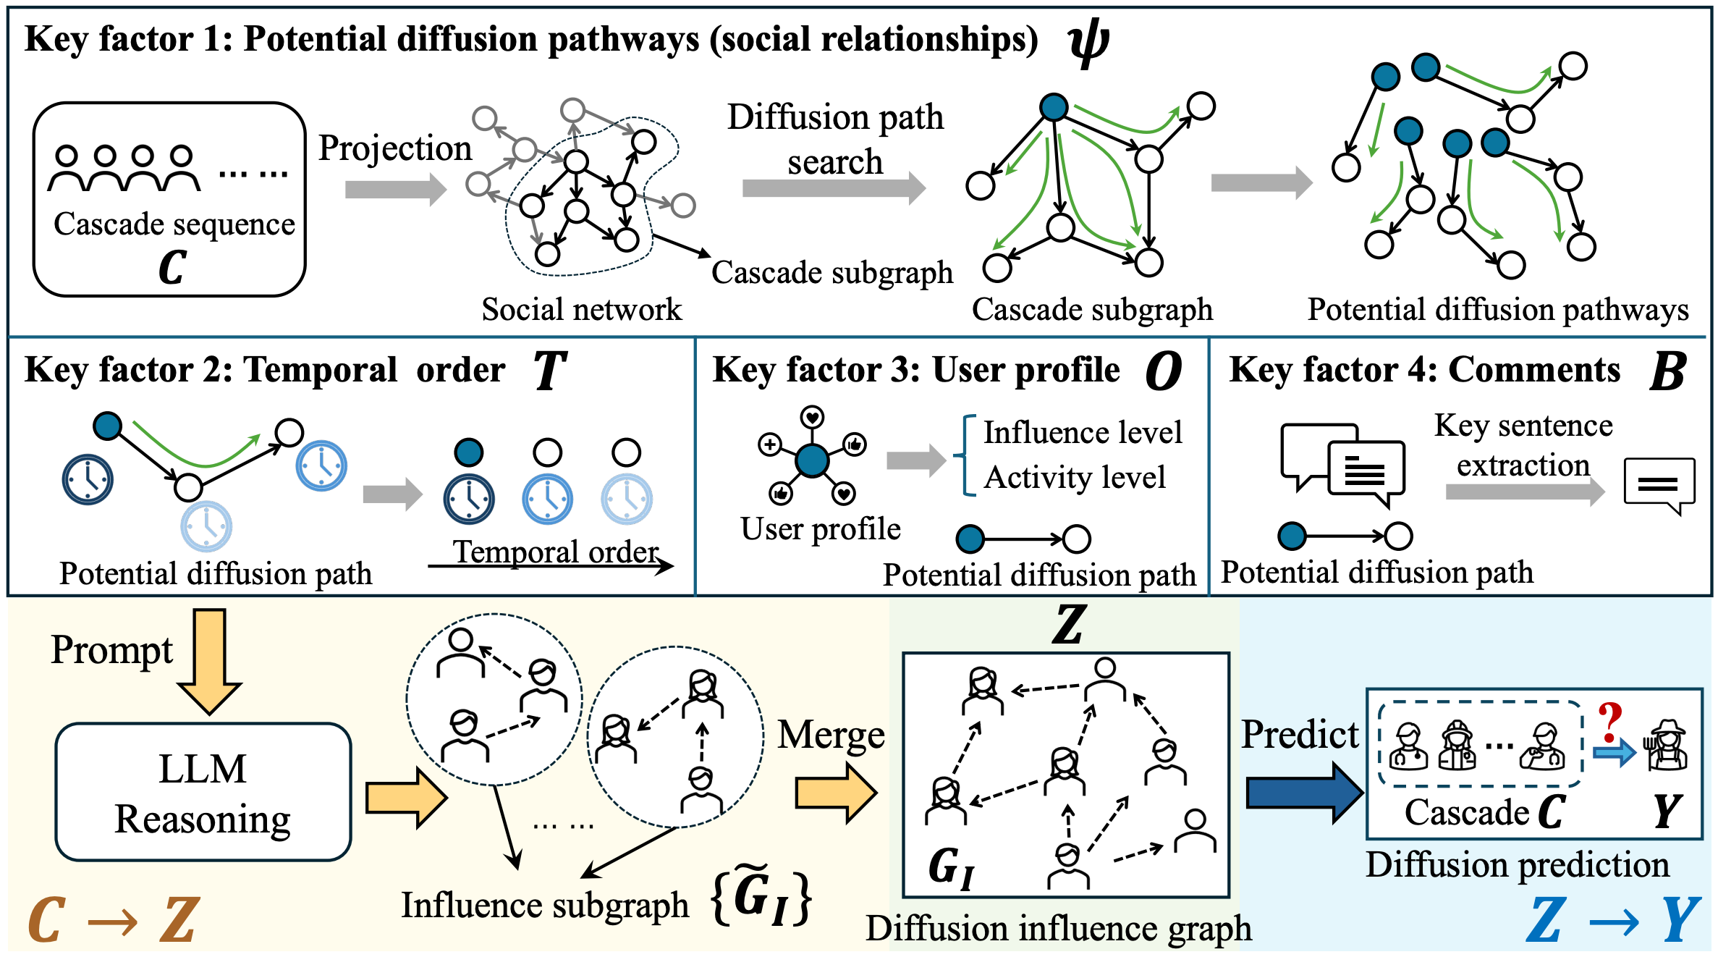
Method
41

Slide 42
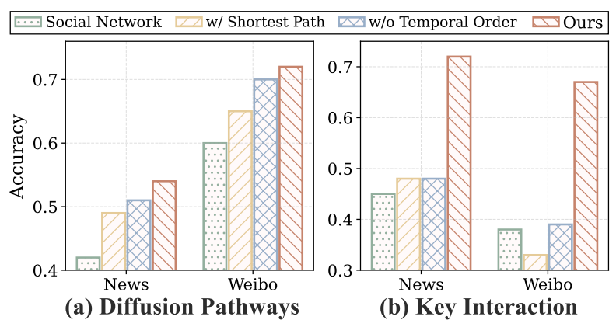
Key Interaction Evaluation
We assess whether GI can observe the high-frequency interactions among participants.
To avoid information leakage, we split the dataset by the cascade initiation time in an 8:2 ratio. We assess whether our method can observe key interactions in the 20% of newly occurred cascades based on the interactions in the 80% of historical cascades.
GI more effectively captures strong ties and key interactions among participants in new cascades.
42

Slide 43
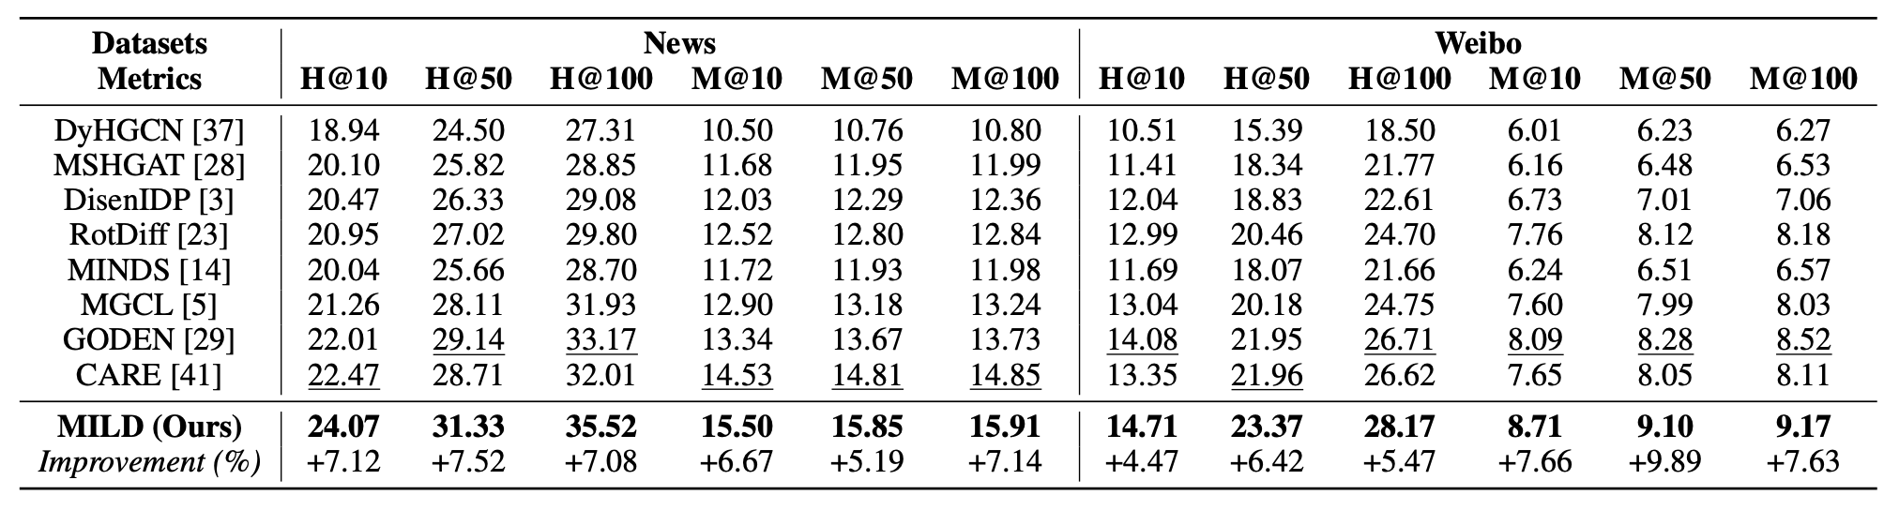
Experiments
Datasets: News and Weibo, including the social network structure, detailed user profiles, and information diffusion cascades.
Competitors: 8 state-of-the-art diffusion prediction methods
MILD significantly outperforms eight state-of-the-art baselines on two real-world information diffusion prediction datasets, achieving average improvements of 6.3% on Hits@K and 7.4% on MAP@K.
43

Slide 44
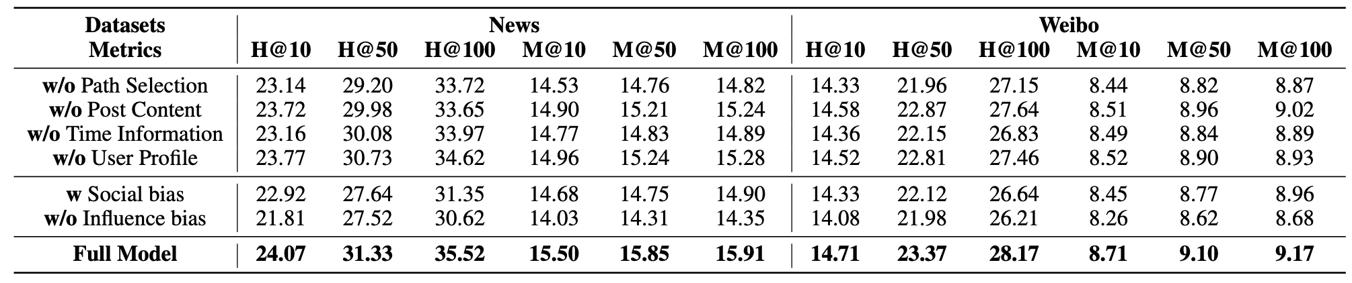
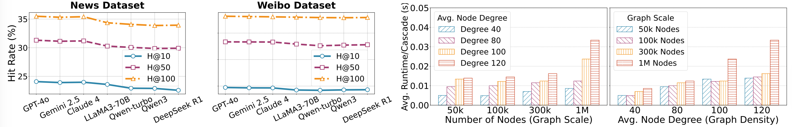
Experiments
Ablation study on Four Key Factors.
Ablation study on GI.
MILD across Different LLMs
44

Slide 45
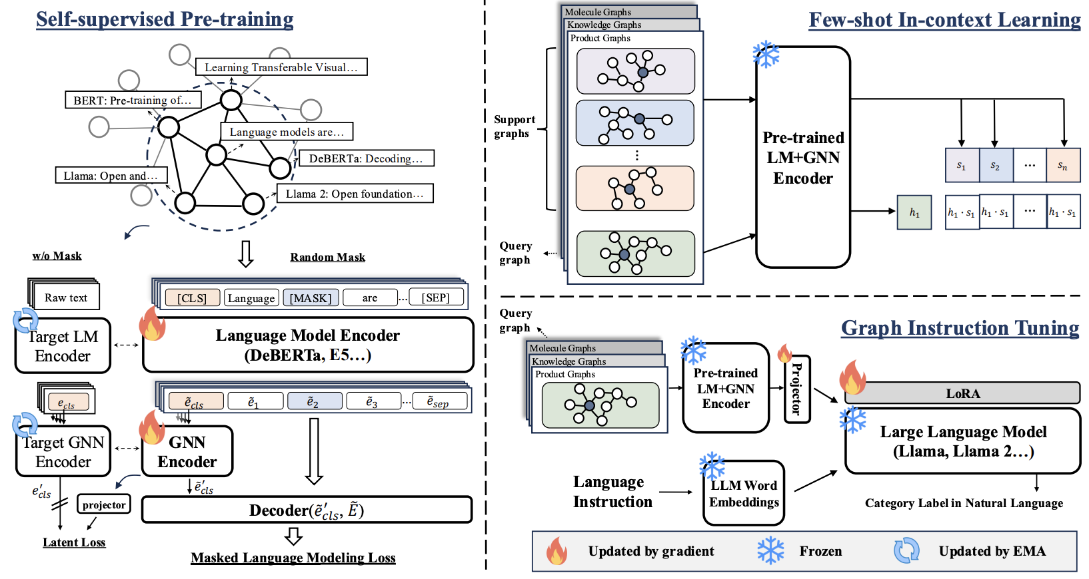
UniGraph: Graph Foundation Model for Text-Attributed Graphs
[1] UniGraph: Learning a Unified Cross-Domain Foundation Model for Text-Attributed Graphs [KDD’25]
45

Slide 46
UniGraph: Graph Foundation Model for Text-Attributed Graphs
UniGraph consists of three main components:
Cascaded LM-GNN Backbone
  Language Model (LM) encoder for processing text attributes
  Graph Neural Network (GNN) encoder for capturing graph structure
  Fusion layer to combine LM and GNN outputs
Graph Siamese Masked Autoencoders
  Masked Language Modeling (MLM) for text understanding
  Latent space regularization for better representation learning
  Target networks with exponential moving average updates
Instruction Tuning
  Zero-shot transfer capabilities
  Task-specific instruction processing
  LoRA-based parameter-efficient fine-tuning
[1] UniGraph: Learning a Unified Cross-Domain Foundation Model for Text-Attributed Graphs [KDD’25]
46

Slide 47
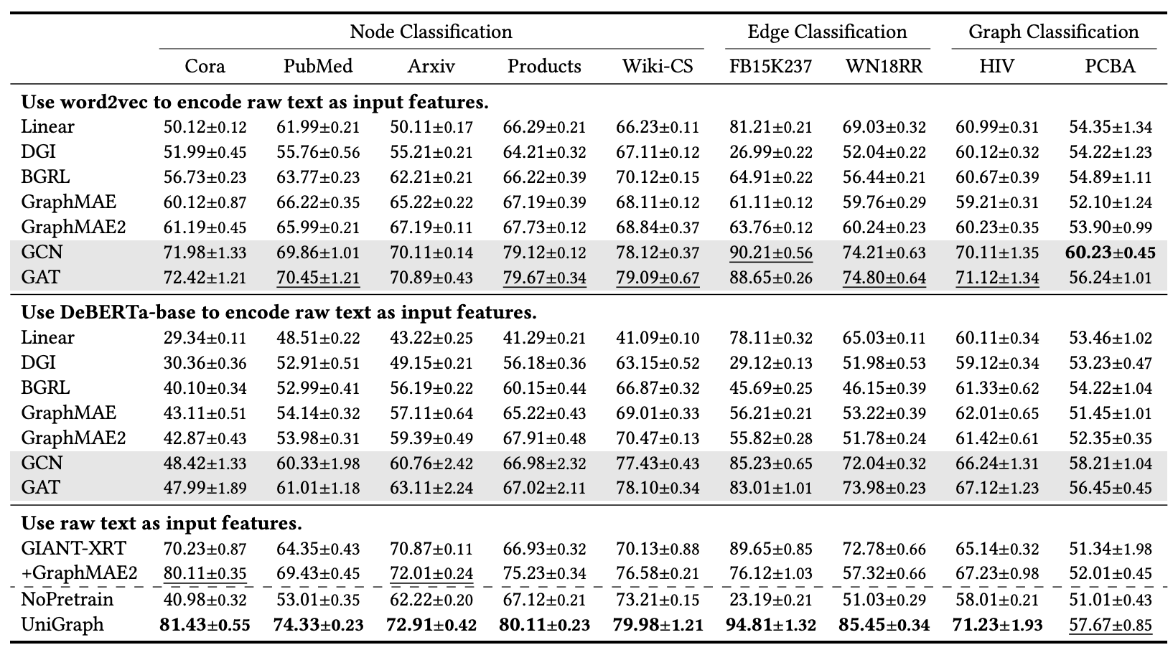
UniGraph: Graph Foundation Model for Text-Attributed Graphs
[1] UniGraph: Learning a Unified Cross-Domain Foundation Model for Text-Attributed Graphs [KDD’25]
47

Slide 48

Graph Foundational Model for All Classification Tasks
[1] One for All: Towards Training One Graph Model for All Classification Tasks [ICLR’24]
48

Slide 49

3. Graphs for LLMs
  A. Question-Answering: GraphRAG
    From RAG to GraphRAG
    RAG vs GraphRAG
  B. Agent Memory: Memory Graph
  C. LLM Planning: WorkFlow Graph
  D. LLM Selection: GraphRouter
Presented by Longxu Sun

Slide 50

From RAG to GraphRAG
Standard RAG retrieves flat text chunks by semantic similarity.
50

Slide 51


From RAG to GraphRAG
GraphRAG enables structure-aware retrieval and generation.
51

Slide 52
GraphRAG Surveys
Most GraphRAG systems can be viewed as a three-stage pipeline:
1. Graph-based indexing
Build graphs, communities, or hierarchical indexes from documents/KGs.
2. Graph-guided retrieval
Retrieve nodes, paths, subgraphs, neighborhoods, or community summaries.
3. Graph-enhanced generation
Generate answers using structured and connected evidence.
Representative directions:
• Community-based global summarization
• Attributed hierarchical retrieval
• Unified analysis and benchmarking: VLDB’25 unified framework
[1] https://arxiv.org/abs/2501.13958
[2] https://arxiv.org/abs/2408.08921
[3] https://papers.ssrn.com/sol3/papers.cfm?abstract_id=6713979
52

Slide 53


From Local to Global: A GraphRAG Approach to Query-Focused Summarization
[1] https://arxiv.org/html/2404.16130v2
53

Slide 54
ArchRAG: Attributed Community-based Hierarchical Retrieval-Augmented Generation [AAAI’26]
Issue | Description
Low Community Quality | Leiden algorithm relies solely on graph structure, ignoring semantic info. Produces mixed-topic communities with poor summaries, degrading performance.
Limited Compatibility | Global and local search operate only at a single granularity. Cannot handle abstract and specific queries simultaneously, limiting real-world applicability.
High Generation Cost | Abstract queries perform well, but analyzing many communities is costly. On Multihop-RAG, 2,984 communities detected; 100 questions required ~$650 and 106M tokens.
Inaccurate Entity Recognition | Methods like HippoRAG show recognition issues: 5.0% of HotpotQA questions missed entities; 15.8% of recognized entities were low quality, causing irrelevant retrieval.
Inaccurate Retrieval Process | Graph RAG often returns irrelevant content during search (e.g., GraphRAG local search inaccuracies), reducing overall performance.

Slide 55

ArchRAG: Attributed Community-based Hierarchical Retrieval-Augmented Generation [AAAI’26]
[1] https://arxiv.org/pdf/2502.09891v2
55

Slide 56

ArchRAG: Attributed Community-based Hierarchical Retrieval-Augmented Generation [AAAI’26]
[1] https://arxiv.org/pdf/2502.09891v2
56

Slide 57

In-depth Analysis of Graph-based RAG in a Unified Framework [VLDB’25]
[1] https://arxiv.org/pdf/2503.04338
57

Slide 58
RAG vs GraphRAG: When Does Graph Help?
RAG works well when:
• Questions ask for local factual details.
• Relevant evidence is contained in a few text chunks.
• Simple and efficient retrieval is preferred.
GraphRAG helps when:
• Questions require multi-hop reasoning.
• Evidence is distributed across the corpus.
• Corpus-level themes, communities, or relationships matter.
• Structured aggregation improves answer coverage and diversity.
Design implication:
GraphRAG should be selected and configured based on task type, graph quality, retrieval granularity, and computational cost.
[1] https://arxiv.org/abs/2502.11371, [2] https://arxiv.org/abs/2509.16780
[3] https://arxiv.org/abs/2411.05844
58

Slide 59

AriGraph: Learning Knowledge Graph World Models with Episodic Memory for LLM Agents [IJCAI’25]
Motivation:
LLM agents need long-term memory to accumulate and reuse knowledge from past interactions.
Key Idea: AriGraph represents agent memory as a graph world model that combines:
• Semantic memory: accumulated general knowledge
• Episodic memory: specific past observations and events
• Graph-based retrieval for planning and decision-making
59

Slide 60

AriGraph: Learning Knowledge Graph World Models with Episodic Memory for LLM Agents [IJCAI’25]
At each step:
1. The agent receives a textual observation.
2. LLM extracts semantic triplets: (object1, relation, object2)
3. Triplets update the semantic memory graph.
4. The original observation is stored as an episodic vertex.
5. Episodic edges link the observation to the extracted triplets.
60

Slide 61

Benchmarking Agentic Workflow Generation [ICLR 2025]
[1] https://arxiv.org/pdf/2410.07869
61

Slide 62

Benchmarking Agentic Workflow Generation [ICLR 2025]
Multi-faceted scenarios.
Complex workflow structures.
Strict quality control and data filtering.
Accurate quantitative evaluation (WorfEval).
[1] https://arxiv.org/pdf/2410.07869
62

Slide 63

Benchmarking Agentic Workflow Generation [ICLR 2025]
[1] https://arxiv.org/pdf/2410.07869
63

Slide 64

GraphRouter: A Graph-based Router for LLM Selections [ICLR 2025]
LLM Selection Process:
User input associated with a specific task
Router analyzes the input and selects the appropriate LLM
Selected LLM generates the final output
Evaluation of the output's effectiveness and cost
Feedback training loop for continuous improvement
[1] https://arxiv.org/pdf/2503.04338
64

Slide 65

GraphRouter: A Graph-based Router for LLM Selections [ICLR 2025]
Overall Framework:
GraphRouter converts the interaction data among tasks, queries, and LLMs into a graph by representing each as nodes and their relationships as edge features. Then, it uses a GNN to generate the probability distribution for selecting the appropriate LLM.
[1] https://arxiv.org/pdf/2503.04338
65

Slide 66

4. KGs for LLMs
  Large Language Models
  Knowledge Graphs
  KGs as background knowledge for LLMs
  KGs as reasoning guidelines for LLMs
  KGs as refiners and validators for LLMs
  LLM+KG for domain-specific applications (e.g., data integration)
Presented by Arijit Khan

Slide 67



LLMs - Introduction
Models the probability of the next word, given the history (context) of preceding words.
LLM models
Generative AI (genAI): AI system whose primary task is to generate content, e.g., GANs, VAEs, RNNs, LLMs, VLMs, VALL-E.
Large Language Models (LLMs): Generative AI systems primarily designed for natural language processing tasks.
Foundation Models (FMs): AI systems serving as the basis for a wide range of AI applications - can be adapted to a range of different, more specific purposes. E.g., LLMs, VLMs, speech FMs.
- often used interchangeably.
Language models text generation
67
Notes:
67

Slide 68

PLMs and LLMs Architecture
GPT, Claude, Llama, ..
Text generation
Emergent properties (text classification, summarization, translation, question answering, and diverse tasks)
New tasks without updating model parameters via prompt-based in-context learning and retrieval augmented generation (RAG)
BERT, RoBERTa, ..
Text comprehension (sentiment analysis, text classification, question-answering, and named entity recognition)
BART, T5 , ..
Both text comprehension and generation (machine translation, summarization, and question answering)
68
Notes:
68

Slide 69

LLMs – Benefits
Emerging abilities; generalizing to unseen tasks; task descriptions provided as text.
Scaling the models, compute, and data leads in increase in performance.
Perform new and creative tasks using prompt-based Interaction and retrieval-augmented generation (RAG) without updating model parameters.
LLM pipelines remove task-specific supervision and need for labeled data – easy to use, less expensive, and fast to iterate.
LLMs act as knowledge bases - can be probed for QA and querying tasks.
Applications of LLMs
69
Notes:
69

Slide 70
LLMs – Challenges
Alignment Problem: LLMs may produce harmful, unsafe, toxic, or undesirable outputs – inappropriate language, misinformation, bias, and discrimination.
Hallucination: Parametric knowledge, lack consistent representations of knowledge, fail to understand a question due to lack of context, knowledge gap (lack up-to-date and domain-specific knowledge), cannot recall facts (about not so popular or long-tail entities), output unreliable and incoherent responses, hallucinate by generating factually incorrect statements.
Lack of Consistency: Generate logically contradicting outputs, low semantic similarity of LLM outputs due to paraphrased versions of a question (meaning-preserving text alternations), violate important relational properties such as negation, symmetry, and transitivity; Adversarial LLM Jailbreaks.
Privacy Concern: Data privacy, personally identifiable information, data retention policy, IP leakage, security vulnerabilities, legal compliance.
Black-box Model: Many LLMs are proprietary and little information is released about them. Difficult to explain LLM predictions with billions of parameters. Knowledge in LLMs is hard to interpret, update, and is prone to bias. Challenging to deploy LLMs in decision-critical applications.
Environmental Concern: High cost, energy consumption, carbon emissions, and water usage.
Societal Impacts: Job loss, disparities, phishing, fraud, manipulation, plagiarism, cheating, fake news, big tech monopolies, societal unrest, …
70
Notes:
70

Slide 71





KGs – Introduction
Integrating knowledge + data at large scale 🡺 Knowledge graph
Google Knowledge
Graph (2012)
“People who like things I like” Facebook graph search (2013)
Panama Papers investigation, led by ICIJ, exposed highly connected networks of offshore tax structures
used by world’s richest elites (2016)
In 2020, Gartner put Knowledge Graphs at the peak of its AI hype cycle (2020)
LLM + KG
(2024 - present)
71
Notes:
71

Slide 72































KGs – Data Sources and Categories
Stanford
Ajim Premji
Maryland
Harvard
Sergey Brin
Bachelor
Of Eng.
studied at
lived
Bill Gates
founded
graduated
went to
Wipro
Microsoft
Jane Stanford
Commonsense KG
founded
founded
citizen
nationality
Jerry Yang
Domain-specific KG
headquarter
founded
nationality
Google
Yahoo!
Steve
Woznaik
Founded in
Seattle
founded
lives in
founded
NeXT
Silicon Valley
Industrial KG
Apple
Factual KG
Knowledge Graph
Personal KG (PKG)
Notes:
72

Slide 73




Knowledge Graphs (KGs) – Components, Representation, and Usage
KG Applications
KG Components
Nodes: entities, concepts, or instances within a domain, e.g., people, places, organizations, concepts, events, etc.
Edges: relationships and connections between nodes, e.g., Is-a relationship, Part-of relationship, Related-to relationship, etc.
Properties: additional descriptive information and metadata associated with nodes or edges, e.g., attributes, features, labels, Qualifiers, metadata, etc.
Ontology: schema and vocabulary used within the KG, providing a structured framework for representing domain knowledge.
KG Representations
RDF Triples: collection of <subject, predicate, object> triples.
Property Graph: graph model having nodes and edges with arbitrary number of properties, where a node (a subject or an object) denotes an entity and a directed edge (a predicate) is a relationship between two entities.
KG Embedding: Vector representation of KG nodes and edges in low-dimensional space, such that the original structures and relations in the KG are preserved in these learned semantic vectors.
RDF Triples
Property Graph
KG Embedding
Notes:
73

Slide 74
KGs – Benefits and Challenges
KG Benefits
structured, highly curated, and reliable representation of knowledge via explicit relationships.
support symbolic reasoning and inference, with answer validation and explainability.
schema-flexible: updated dynamically with new knowledge via addition or deletion of triples/ nodes & edges.
offer accurate explicit knowledge in many downstream applications, e.g., web search, QA, semantic search, personal assistants, fact-checking, and recommendation.
KG Challenges
Difficult to construct.
Difficult to query due to incompleteness, schema-flexibility, heterogeneity, and massive-scale.
User Barriers in SPARQL/Cypher‑Style Querying: non-professional users find it challenging to write an accurate query, e.g., via SPARQL, Cypher, Gremlin, GSQL, etc., since users must have full knowledge of the query language, schema, and the vocabulary used in a KG. Current KG querying approaches generally lack language understanding, are inadequate to deal with unseen entities and new facts, and often ignore multi-modal information in KGs.
Interoperability issue: existing methods are tailored for specific KGs or downstream tasks.
74
Notes:
74

Slide 75
LLMs+ KGs: Synergy
KG for LLM
KGs offer external knowledge (up-to-date, domain specific, and symbolic knowledge) for enhancing the accuracy, consistency, transparency, and the overall capabilities of LLMs.
KG-enhanced pre-training, fine-tuning, and inference (KG-RAG).
KG-enhanced validation (LLM guardrail) and explainability.
LLM for KG
LLMs augment KGs via knowledge extraction, auto-completion, and incorporating multi-modal information, enhancing usability and performance of downstream tasks with natural language understanding and generalization capabilities.
LLM-enhanced KG creation and completion.
LLM-enhanced KG embedding.
LLM-enhanced KG querying, analytics, and domain-specific applications.
LLM+KG
Downstream applications benefit from the complementarity of LLMs and KGs – LLMs and KGs offer parametric vs. explicit knowledge, respectively.
75
Notes:
75

Slide 76

Role of KGs in Synthesizing with LLMs
Our Recent Survey
  LLMs Meet Knowledge Graphs for Question Answering: Synthesis and Opportunities [EMNLP Main 2025] https://github.com/machuangtao/LLM-KG4QA
Chuangtao Ma, Yongrui Chen, Tianxing Wu, Arijit Khan, and Haofen Wang, "Large Language Models Meet Knowledge Graphs for Question Answering: Synthesis and Opportunities", in Conference on Empirical Methods in Natural Language Processing 2025 (Main).
76

Slide 77
Question Answering (QA): Introduction
QA: QA deals with answering unstructured natural language questions (NLQs) – it also includes a natural language understanding task.
QA Categories
Simple vs. Complex Questions:
  Simple question 🡪 a single triple and a single relation, e.g., “where was Albert Einstein born?” can be answered based on the relation ‘born’: <Albert Einstein, born, ?place>.
  Complex question 🡪 multiple KG relations (multi-hop) and/or additional operations (e.g., aggregate, order, temporal), e.g., “what was the first movie of James Cameron that own an Oscar?”
QA Applications
Multi-document QA
Multi-lingual QA
Multi-modal QA
Multi-run and conversational QA
Temporal QA
Factoid QA
Explainable QA
Text generation, chatbots, dialog generation, web search, entity linking, natural language query, fact-checking, …
Open-domain QA, domain-specific QA
AI, NLP, information retrieval, and data management
77
Notes:
77

Slide 78
LLM+KG for QA: Motivation and Challenges
PLMs & LLMs for QA based on their pre-trained knowledge and natural language understanding capabilities [35]
Challenges of PLMs and LLMs in QA
Limited reasoning ability for complex QA
Lack of up-to-date and domain-specific knowledge
Hallucination and inconsistency
Motivation of KGs+LLMs in QA
KGs can offer external, precise, up-to-date, and domain-specific knowledge to LLMs via pre-training, fine-tuning, and RAG (Graph RAG, KG-RAG)
Improve LLM’s accuracy and consistency
Support answer validation (LLM guardrail) and explainability.
Challenges of KGs+LLMs in QA
Knowledge conflict
Poor relevance and quality of retrieved data, limited context size of LLMs
Large-scale and dynamic KGs
Lack of iterative and multi-hop reasoning:
78
Notes:
78

Slide 79

LLM+KG for QA: Roles of KG in Complex QA
79
Notes:
79

Slide 80
Relevant Tutorials
QA, LLMs, KG
Danqi Chen and Wen tau Yih. 2020. Open-domain question answering. In ACL. 34–37.
Lihui Liu, Zihao Wang, Jiaxin Bai, Yangqiu Song, and Hanghang Tong. 2024. New frontiers of knowledge graph reasoning: Recent advances and future trends. In WWW. 1294–1297.
Jizhi Zhang, Keqin Bao, Yang Zhang, Wenjie Wang, Fuli Feng, and Xiangnan He. 2024. Large language models for recommendation: Progresses and future directions. In WWW Companion (2024). 1268–1271.
LLMs+KGs/Graphs, RAG
Wenqi Fan, Yujuan Ding, Liangbo Ning, Shijie Wang, Hengyun Li, Dawei Yin, Tat-Seng Chua, and Qing Li. 2024. A survey on RAG meeting LLMs: Towards retrieval-augmented large language models. In SIGKDD. 6491–6501.
Chao Huang, Xubin Ren, Jiabin Tang, Dawei Yin, and Nitesh Chawla. 2024. Large language models for graphs: Progresses and directions. In WWW. 1284-1287.
Qiang Zhang, Jiaoyan Chen, Zaiqiao Meng. 2024. Integrating Knowledge Graphs and Large Language Models for Advancing Scientific Research. Learning on Graph Conference (LoG).
Chuangtao Ma, Yongrui Chen, Tianxing Wu, Arijit Khan, and Haofen Wang, "Unifying Large Language Models and Knowledge Graphs for Question Answering: Recent Advances and Opportunities ", in EDBT 2025.
80
Notes:
80

Slide 81

KGs as Background Knowledge
KGs and Text Alignment: Joint Learning with PLMs
  Where are KGs?
  - KGs and text data are stored separately (Common scenario for QA task)
  - KGs (entities or relations) having the textual description (Text-KG pair)
Entity Linking
KG Retrieval
  Joint learning
81

Slide 82



KGs as Background Knowledge
Knowledge Integration and Fusion
  Joint Learning: Unified representation for KG and PLM [ACL2021]
    - Encode textual description of entity as entity embeddings and jointly train the KE and MLM on the same PLM
Joint loss for knowledge embeddings and masked language model
Wang, X., et al. A unified model for knowledge embedding and pre-trained language representation. ACL, 2021, 9: 176-194.
82

Slide 83


KGs as Background Knowledge
Knowledge Integration and Fusion
  Joint Learning: Bidirectional language and KG pretraining [NeurIPS2022]
    - Retrieving relevant subgraph from KG based on text to create text-KG pair.
    - Leveraging cross-modal encoder that fuses the input text-KG pair bidirectionally.
    - Unifying masked LM and KG link prediction for and joint learning reasoning.
Modality interaction (Mint) with interaction token and node to mix representation for joint learning
Yasunaga, Michihiro, et al. Deep bidirectional language-knowledge graph pretraining. Advances in Neural Information Processing Systems 35 (2022): 37309-37323.
83

Slide 84


KGs as Background Knowledge
Knowledge Integration and Fusion
  Fine-tuning: Parameter-efficient fine-tuning (KG-Adapter) [ACL 2024]
  Only ~28M adapter parameters are trained, while the 7B‑parameter LLM remains frozen.
  KG-FIT (NeurIPS 2024): fine‑tunes the KG itself using open‑world knowledge extracted from LLMs.
Shiyu Tian et al. KG-Adapter: Enabling Knowledge Graph Integration in Large Language Models through Parameter-Efficient Fine-Tuning. ACL 2024.
Jiang, Pengcheng, et al. KG-FIT: Knowledge graph fine-tuning upon open-world knowledge. Advances in Neural Information Processing Systems 37 (2024): 136220-136258.
84

Slide 85


KGs as Background Knowledge
Retrieval Augmented Generation (RAG): from PLM to LLM
  Semantic RAG: retrieve document or chunks with limited reasoning abilities
  KG-RAG: retrieve subgraph (triples) from KGs with factual-based relationships
  LLM vs RAG vs Graph RAG
  How to fuse and align LLM and KG ?
  Prompt-based Augmentation
Xiangrong, Zhu, et al. Knowledge Graph-Guided Retrieval Augmented Generation. arXiv preprint arXiv:2502.068641 (2025).
Baek, Jinheon, et al. Knowledge-augmented language model prompting for zero-shot knowledge graph question answering. arXiv preprint arXiv:2306.04136 (2023).
85

Slide 86


KGs as Reasoning Guidelines
KGs serves as reasoning guidelines to LLMs for QA
  Offline KG guidelines: KGs-based reasoning before LLMs reasoning
  Online KG guidelines: KGs-based reasoning directly involves in LLMs reasoning
  Agent-based KG guidelines: Agent-based autonomous reasoning
Offline explicit reasoning on KG chains
Online
implicit
reasoning
Liu, Guangyi, et al. Dual Reasoning: A GNN-LLM Collaborative Framework for Knowledge Graph Question Answering. CPAL, (2025).
86

Slide 87



KGs as Reasoning Guidelines
Online KG Guidelines
  KG-based CoT Reasoning for KGQA [EMNLP, 2024]
    Integrate the reasoning process and subgraphs into knowledge retrieval
    Employ instruction tuning and continual pre-training to learn the KG reasoning
Ji, Yixin, et al. Retrieval and reasoning on KGs: Integrate knowledge graphs into large language models for complex question answering. EMNLP. (2024).
87

Slide 88

KGs as Reasoning Guidelines
Agent based Reasoning
  KG-Agent: Agent-based autonomous reasoning for KGQA [ACL 2025]
Instruction-tuned LLM for planner
KG-based executor for knowledge updating
Agent-based autonomous reasoning over KG
Agent autonomously iterates the tool selection and knowledge updating for reasoning util reaching the answer entities
Example of instruction fine-tuning data synthesis and KG reasoning for the input-output pairs
Jiang, Jinhao, et al. KG-Agent: An efficient autonomous agent framework for complex reasoning over knowledge graph. https://aclanthology.org/2025.acl-long.468/ (2025).
88

Slide 89

KGs as Refiners and Validators
Refine and validate the answers for QA
  KG-Driven Filtering and Validation: validate and filter out the incorrect answers
  KG-Augmented Output Refinement: refine intermediate output for final answer
Guan, Xinyan, et al. Mitigating large language model hallucinations via autonomous knowledge graph-based retrofitting. AAAI. (2024).
89

Slide 90
Takeaways
KG-RAG
  Vector-based graph retrieval: vector-based search is time-consuming and computing-consuming task for large KGs.
  Query-based graph retrieval: convert NLQ to GQL is still a challengeable task as the specific schema structure is agnostic for LLMs.
KG-guided Reasoning
  Complex reasoning: reasoning over the large-scale KGs is a time-consuming and computing-consuming task.
  Faithful reasoning: generate the reasoning paths from KGs relies on the prompt and tuning LLMs while the faithful of the KG reasoning need to be addressed.
LM and KG Alignment
  Effective knowledge fusion: integrating LLMs with KGs with the prompt-based fusion is not the optimal one as the topological information of KGs will be lost during the conversion.
  Knowledge conflicts mitigation: the knowledge conflicts between the internal knowledge of LLMs and the retrieved external knowledge need to be mitigated.
90

Slide 91
KG for LLM: Domain-specific Applications
Bishwamittra Ghosh, Sarah Hasan, Naheed Anjum Arafat, and Arijit Khan, "Logical Consistency of Large Language Models in Fact-checking", in ICLR 2025.
Feiyang Li, Peng Fang, Zhan Shi, Arijit Khan, Fang Wang, Weihao Wang, Xin Zhang, and Yongjian Cui, "CoT-RAG: Integrating Chain of Thought and Retrieval-Augmented Generation to Enhance Reasoning in Large Language Models", in EMNLP 2025 (Findings)
Chuangtao Ma, Sriom Chakrabarti, Arijit Khan, and Balint Molnar, "Knowledge Graph-based Retrieval-Augmented Generation for Schema Matching, under submission. https://arxiv.org/abs/2501.08686
Chuangtao Ma, Zeyu Zhang, Arijit Khan, Sebastian Schelter, and Paul Groth, "Cost-Efficient RAG for Entity Matching with LLMs: A Blocking-based Exploration“, under submission. https://arxiv.org/abs/2602.05708
91

Slide 92


Logical Consistency of Large Language Models in Fact-checking
[ICLR 2025]
What is their consistency over logically equivalent changes in the input query?
How to improve an LLM's consistency under logically equivalent perturbation in input query?
92

Slide 93

COT-RAG (EMNLP 2025): Background
《Chain-of-Thought Prompting Elicits Reasoning in Large Language Models》 by Google in NeurIPS 2022
93

Slide 94

Motivation 1 ： The low reliability of relying solely on LLMs to generate reasoning chains
94

Slide 95

Motivation 2 ： The poorer reasoning performance from natural language prompts compared with code prompts
The above Table demonstrates the poor performance of natural-language reasoning methods (CoT, LtM)
Prior work[2,3] establishes the superior performance of code over natural language prompts.
[1] Faithful Chain-of-Thought Reasoning. IJCNLP-AACL 2023
[2] PAL: Program-aided Language Models. ICML 2023
[3] AdaPlanner: Adaptive Planning from Feedback with Language Models. NeurIPS 2023
95

Slide 96

CoT-RAG: A reasoning framework integrating Chain-of-Thought (CoT) and Retrieval-Augmented Generation (RAG)
96

Slide 97

Knowledge Graph-driven CoT Generation
Key Innovations：
Structuring LLM reasoning with expert-defined, coarse-grained decision trees
Decomposing trees into fine-grained knowledge graphs to model complex relationships
97

Slide 98

Learnable Knowledge Case-aware RAG
Key Innovations：
Extracting sub-descriptions from user queries by retrieving relevant sub-cases from the knowledge graph
Updating the decision tree dynamically based on user input to optimize the knowledge graph
98

Slide 99

Pseudo-Program Prompting Execution
Key Innovations：
Replaces natural language with structured pseudo-code prompts to boost the logicality of LLM-generated reasoning chains
Leverages the clear structure and broad applicability of pseudo-program
99

Slide 100

Experimental Results
  CoT-RAG significantly outperforms the existing CoT methods on 9 datasets in the fields of arithmetic, common sense, and symbols, with an accuracy improvement of 4.0% - 44.3%
100

Slide 101

Experimental Results
  CoT-RAG significantly outperforms existing Graph form LLM based RAG methods on four datasets across three vertical domains of law, finance, and logic, with an accuracy improvement of 8.9% -40.6%
101

Slide 102
Summary
Motivation:
① The low reliability of relying solely on LLMs to generate reasoning chains
② The poorer reasoning performance from natural language prompts compared with code prompts
Method:
A reasoning framework integrating Chain-of-Thought (CoT) and Retrieval-Augmented Generation (RAG)
  Key Technique 1：Knowledge Graph-driven CoT Generation
  Key Technique 2：Learnable Knowledge Case-aware RAG
  Key Technique 3：Pseudo-Program Prompting Execution
  Experimental Results：
  Compared with CoT methods, CoT-RAG has increased accuracy by 4.0% -44.3%, and compared with Graph form LLM based RAG methods, accuracy has increased by 8.9% -40.6%
Key Achievement：
  CoT-RAG: Integrating Chain of Thought and Retrieval-Augmented Generation to Enhance Reasoning in Large Language Models. EMNLP Findings 2025
102

Slide 103


KG-RAG4SM
KG+LLM for domain-specific schema matching https://arxiv.org/abs/2501.08686
Challenges: LLMs without sufficient background knowledge tend to hallucinate results for schema matching and retrieve the relevant subgraphs from the large-scale external KG is expensive.
Motivation: We introduce a KG-based RAG for schema matching that integrates multiple retrieval mechanisms to extract the relevant subgraphs from KGs for augmenting LLMs in schema matching.
Figure: Example of schema matching in the EHR data model.
Figure :The Role of KG context in augmenting LLMs for schema matching.
103

Slide 104

KG-RAG4SM
Method: We introduce a novel KG-RAG4SM that identifies the most relevant subgraphs from external large KGs to augment LLMs for schema matching.
  Retrieve the relevant KG triplets based on vector similarity search between questions embeddings and KG triplet embeddings
  Prune the retrieved relevant KG triplets with vector similarity-based ranking.
  Augment prompts with the retrieved and refined subgraphs from large-size KG and generate the final answer for the given schema matching questions.
Figure: Overview of our proposed KG-RAG4SM method
104

Slide 105


KG-RAG4SM
Results: The results on 6 benchmark across domains demonstrated that our KG-RAG4SM outperforms PLMs and LLM-based SOTA methods in terms of effectiveness and efficiency.
Figure : Effectiveness of KG-RAG4SM against LLM baseline
Figure : Effectiveness of KG-RAG4SM against PLM baseline
105

Slide 106

KG-RAG4SM
Results: The results on 6 benchmark across domains demonstrated that our KG-RAG4SM outperforms PLMs and LLM-based SOTA methods in terms of effectiveness and efficiency.
Efficiency of KG-RAG4SM against LLM and PLM baselines
106

Slide 107


CE-RAG4EM
KG+LLM for domain-specific entity matching https://arxiv.org/abs/2602.05708
Challenges: The knowledge grounding gap in LLM-based entity matching and costly retrieval and inference overhead in directly adapting vanilla RAG to entity matching in large-scale data integration.
Motivation: We propose a blocking-based batch preprocessing strategy that groups similar records into the same batch, reducing redundant retrieval and inference for efficient RAG-based entity matching.
Figure : Vanilla RAG4EM vs. CE-RAG4EM. Matched records share the same color.
107

Slide 108

CE-RAG4EM
Method: We introduce a cost-efficient RAG framework for zero-shot entity matching that reduces computation through blocking-based batch retrieval and generation.
Figure: Overview of CE-RAG4EM. The framework consists of five phases (a)–(e). A check mark indicates that the LLM predicts Yes for the corresponding EM query, whereas a cross mark indicates No.
108

Slide 109

CE-RAG4EM
Method: We design a space exploration of CE-RAG4EM is structured around two core dimensions: blocking-based optimization and retrieval granularity.
 | Retrieval Granularity (RG)
(Batch Optimization) BO | Entity & Predicate | Triple
Batch Retrieval (BR) | CE-RAG4EM-BR | CE-KG-RAG4EM-BR
Batch Generation (BG) | CE-RAG4EM-BG | CE-KG-RAG4EM-BG
BR & BG | CE-RAG4EM-BR-BG | CE-KG-RAG4EM-BR-BG
Table: Summary of the Design Solutions of CE-RAG4EM.
109

Slide 110



CE-RAG4EM
Results: Extensive experiments on nine benchmark datasets show that CE-RAG4EM achieves comparable or improved matching quality while substantially reducing end-to-end overhead.
Overall Performance CE-RAG4EM vs. LLM-EM
Overall Performance CE-RAG4EM vs. PLM-EM
Efficiency comparison of CE-RAG4EM against (a) LLM-EM and (b) PLM baselines.
110

Slide 111
4. KGs for LLMs
  Large Language Models
  Knowledge Graphs
  KGs as background knowledge for LLMs
  KGs as reasoning guidelines for LLMs
  KGs as refiners and validators for LLMs
  LLM+KG for domain-specific applications (e.g., data integration)
Questions?
Presented by Arijit Khan

Slide 112
5. LLMs for Knowledge Graphs
  A. Knowledge Graph Link Prediction
  B. Knowledge Graph Embedding
  C. Knowledge Graph Construction
  D. Knowledge Graph Completion
Presented by Longxu Sun

Slide 113

Unifying LLMs and Knowledge Graphs
1. KG-enhanced LLMs
Use KGs to improve LLM pre-training, inference, or interpretability.
2. LLM-augmented KGs
Use LLMs for KG embedding, completion, construction, QA, and graph-to-text generation.
3. Synergized LLMs + KGs
Jointly leverage LLMs and KGs for bidirectional reasoning.
[1] https://arxiv.org/pdf/2306.08302
113

Slide 114

Knowledge Graph Large Language Model (KG-LLM) for Link Prediction [ACML’24]
KG-LLM idea:
• Convert KG paths into natural-language prompts.
• Use chain-of-thought style reasoning over KG paths.
• Fine-tune LLMs with instruction-following objectives.
• Predict whether two nodes are connected, or what relation holds between them.
[1] https://arxiv.org/pdf/2403.07311
114

Slide 115

LambdaKG: A Library for Pre-trained Language Model-Based Knowledge Graph Embeddings
[1] https://ar5iv.labs.arxiv.org/html/2210.00305
115

Slide 116



Extract, Define, Canonicalize: An LLM-based Framework for Knowledge Graph Construction [EMNLP’24]
[1] https://arxiv.org/pdf/2404.03868
116

Slide 117





Extract, Define, Canonicalize: An LLM-based Framework for Knowledge Graph Construction [EMNLP’24]
Augmented
Input
Query
Generate
Input Text
Retriever
EDC
Refined KG
Look-up
Relevant
Components
KG Schema
[1] https://arxiv.org/pdf/2404.03868
117

Slide 118

Extract, Define, Canonicalize: An LLM-based Framework for Knowledge Graph Construction [EMNLP’24]
Final Knowledge Graph:
[‘Alan Shepard’, ‘birthDate’, ‘Nov 18, 1923’]
[‘Alan Shepard’, ‘mission’, ‘Apollo 14’]
[‘Alan Shepard’, ‘selectedByNasa’, ‘1959’]
[1] https://arxiv.org/pdf/2404.03868
118

Slide 119

LGC-CR: Few-shot Knowledge Graph Completion via LocalGlobal Contrastive Learning and LLM-Guided Refinement [CIKM’25]
How to effectively achieve knowledge graph completion under few-shot conditions?
few-shot relation: playfor
[1] https://dl.acm.org/doi/epdf/10.1145/3746252.3761000
119

Slide 120

LGC-CR: Few-shot Knowledge Graph Completion via LocalGlobal Contrastive Learning and LLM-Guided Refinement [CIKM’25]
(a) Local-Global Neighbors Contrastive Network (b) Fusion-based Similarity Network (c) LLM-guided Refinement
[1] https://dl.acm.org/doi/epdf/10.1145/3746252.3761000
120

Slide 121


LGC-CR: Few-shot Knowledge Graph Completion via LocalGlobal Contrastive Learning and LLM-Guided Refinement [CIKM’25]
Cross-Attention Local Enhancement.
Neighbors more task-relevant receive higher weights.
Neighbors more similar to paired entities receive higher weights.
(1)Task-aware (2)Entity pair-aware
ResGCN-FilGAT Global Enhancement.
one-hop: stable and comprehensive
high-order: Not all neighbors matter: adaptive filtering based on structure-semantic dissimilarity.
[1] https://dl.acm.org/doi/epdf/10.1145/3746252.3761000
121

Slide 122
LGC-CR: Few-shot Knowledge Graph Completion via LocalGlobal Contrastive Learning and LLM-Guided Refinement [CIKM’25]
• A fusion similarity network
integrates three complementary similarity metrics, which constructs a learnable non-linear metric space.
• Hard Negative Loss
Instead of treat all negative samples equally, focus more on hard negative samples that are difficult to distinguish during training.
[1] https://dl.acm.org/doi/epdf/10.1145/3746252.3761000
122

Slide 123


LGC-CR: Few-shot Knowledge Graph Completion via LocalGlobal Contrastive Learning and LLM-Guided Refinement [CIKM’25]
Instruction Retrieval
Retrieve query-relevant structural and semantic knowledge.
Knowledge Selector
Diversity-aware Sampling: selects representative relations covering diverse KG information.
Centrality-aware Sampling: focusing on high-centrality relations while avoiding noise.
123

Slide 124
6. Graphs for AI Agents
  AI Agents
  Agent Interaction With Task Planning Graphs
  Agent Interaction With Task Execution Graphs
  Agent Interaction With Memory Graphs
  Multi-Agent Coordination Graphs
Presented by Arijit Khan

Slide 125


Agents - Introduction
LLM models
What would we like an agent to do? - ACT!
Agentic systems autonomously make decisions and take actions to achieve a specified goal, operating within the constraints of their environment and design.
Components of an Agent:
Required: Grounding, Agency, Planning, Memory, Learning
Additional: Embodiment, Communication, World Modeling, Multimodality
125
Notes:
125

Slide 126



AI Agents
126
Notes:
126

Slide 127


AI Agents
Generative AI produces content such as text, code, or intermediate reasoning steps.
Agentic AI refers to architectures that use these models to plan, reason, and orchestrate multi‑step workflows.
AI Agents are the concrete entities that carry out those workflows by invoking tools, interacting with environments, and executing actions.
127
Notes:
127

Slide 128

Agentic AI Frameworks
128
Notes:
128

Slide 129

Graphs Meet AI Agents [Bei et al., https://arxiv.org/abs/2506.18019]
129
Notes:
129

Slide 130

Graphs for Agentic Planning
130
Notes:
130

Slide 131



Graph-of-Thought Reasoning
131
Notes:
131

Slide 132


Task Decomposition and Dependency Graph
Z. Gao, Y. Mu, J. Qu, M. Hu, L. Guo, P. Luo, and Y. Lu, “Dag-plan: Generating directed acyclic dependency graphs for dual-arm cooperative planning,” arXiv preprint arXiv:2406.09953, 2024
X. Wu, Y. Shen, C. Shan, K. Song, S. Wang, B. Zhang, J. Feng, H. Cheng, W. Chen, Y. Xiong et al., “Can graph learning improve planning in llm-based agents? NeurIPS 2024.
132
Notes:
132

Slide 133

Graphs for Agentic Execution
133
Notes:
133

Slide 134
Graph-based Agentic Tool Learning
HuggingGPT
01
Solving Diverse AI Tasks by Connecting ChatGPT with Hugging Face Models
TaskBench
02
A Comprehensive Benchmark for Evaluating LLM Agents on Task Automation
Tool-Planner
03
Enhancing Task Planning with Clusters across Multiple Specialized Tools
134

Slide 135

135

Slide 136

HuggingGPT: The Four-Stage Pipeline
136

Slide 137

Illustration of Task Planning in HuggingGPT
137

Slide 138
HuggingGPT: Key Results & Findings
Effectiveness on Complex Tasks
Performance Dependence on Controller
Key Limitations Identified
HuggingGPT successfully completed a wide range of challenging tasks that are difficult for any single model, demonstrating the power of the "LLM as a controller" paradigm.
The choice of controller LLM (GPT-3.5 vs. GPT-4) significantly impacted results. GPT-4, with its superior reasoning ability, led to a much higher success rate in task planning and model selection.
Latency: Significant delays from chaining multiple calls.
Error Propagation: Planning mistakes lead to complete failure.
Context Limit: Constrained by the LLM's context window size.
Broader Impact: The Catalyst for LLM Agents
HuggingGPT demonstrated that the true power of LLMs lies not just in their internal knowledge, but in their ability to interact with and leverage external tools and models. It acted as a critical catalyst for the "LLM Agent" movement, shifting focus towards building autonomous systems that can coordinate specialized models to solve complex real-world problems.
138

Slide 139


Slide 140
TaskBench: Motivation & Core Problem
The Core Problem
Task Complexity
Tool Usage
Covering a wide spectrum of difficulties to challenge agents at various skill levels.
Incorporating external tools (APIs, databases) to mimic real-world workflows.
As LLM agents become more prevalent, there is a lack of standardized, comprehensive benchmarks to evaluate their ability to automate complex tasks.
Reasoning Steps
Real-World Scenarios
Existing benchmarks often focus on isolated capabilities(e.g., coding, reasoning) rather than the holistic ability to complete end-to-end tasks.
Requiring agents to plan, decompose, and execute long, multi-step sequences.
Using practical, meaningful tasks that reflect actual industry and daily needs.
140

Slide 141

LLM-Based Task Automation
141

Slide 142

TaskBench: Benchmark Design
142

Slide 143
TaskBench: Benchmark Design
01. Task Taxonomy
02. Task Creation
03. Evaluation Metrics
A comprehensive classification system defining tasks along three key dimensions:
Tasks are engineered for realism, mirroring real-world automation scenarios with well-defined parameters:
A multi-dimensional assessment framework to quantify agent performance:
Domain Scope
Software Dev, Data Analysis, Support
Clear Definition:Specific goal, input data & output.
Success Rate
Ability to complete the task correctly.
Complexity Level
Steps count, tooling needs, cognitive load
Efficiency
Minimizing steps and token consumption.
Example Scenario:
Process CSV sales data → Calculate regional revenue → Generate chart → Write summary.
Functional Type
Extraction, Transformation, Decision-Making
Robustness
Handling input variations & unexpected errors.
143

Slide 144
TaskBench: Key Features & Capabilities Tested
Tool Usage
Multi-step
Planning
Robustness &
Adaptability
APIs: RESTful services for real-time data retrieval.
DBs: SQL queries for data manipulation.
Code: Python execution for data processing.
Files: Full read/write filesystem interaction.
Agents must execute tasks in a strict logical sequence, understanding complex dependencies between steps.
Example: Calculate quarterly revenue first, then use that result to generate a trend visualization.
Designed to test resilience against ambiguous inputs and simulated failures.
Example: Clarifying vague user requests or recovering gracefully from a broken API endpoint.
144

Slide 145
TaskBench: Example Task Walkthrough
Task: Customer Support Ticket Resolution
Primary Goal
01. Query Order Database
04. Generate Response
Execute SQL query using the Order ID to fetch critical details (current status, shipping address).
Draft a personalized email with tracking info and resolution details (e.g., unique discount code).
Successfully resolve a customer complaint regarding a delayed order by gathering info and providing a resolution.
02. Check Shipping API
05. Log Final Action
Initial Input
Call external shipping API to retrieve real-time package location and latest delivery status update.
Update the support ticket database with the full resolution log for future reference.
A raw customer support ticket containing the specific Order ID and a free-text description of the delay issue.
03. Analyze & Decide
TASK OUTCOME
Evaluate status; offer discount if delay is significant.
Validates agent's ability to handle DB, API, reasoning, and generation.
145

Slide 146
TaskBench: Experimental Results
Key Findings from Initial Benchmarking
Performance Variability
Tool Mastery is Key
A significant performance gap exists between LLMs. Top-tier models (GPT-4, Claude 3) consistently outperformed smaller models in success rate and task efficiency.
Models demonstrating strong tool understanding performed significantly better. This includes correctly formatting API calls and accurately parsing JSON responses from tools.
Planning vs. Execution
Common Failure Modes
Capability divergence was observed: some models excelled at creating detailed plans but failed in execution (e.g., syntax errors), while others were strong executors but poor planners.
Key breakdowns included incorrect tool selection for subtasks, passing invalid arguments (parameter errors), and planning oversights (missing critical workflow steps).
146

Slide 147
TaskBench: Discussion & Significance
Standardized Evaluation
Broader Impact & Value
Established a common ground for comparing the task automation capabilities of diverse LLM agents objectively.
A Diagnostic Tool (Not Just a Test)
Revealing Limitations
TaskBench helps developers understandwhyan agent failed a task, delivering actionable, granular feedback that accelerates the iteration and improvement cycle.
Systematically identified key failure modes, providing crucial insights to guide targeted R&D for future agents.
Cornerstone of the LLM Agent Community
Promoting Innovation
It has become the de facto standard for evaluating progress, enabling researchers worldwide to build on each other's work and move the field forward collectively.
Encourages healthy competition and drives the evolution of LLM-based automation.
147

Slide 148


Slide 149
Tool-Planner: Motivation & The Problem of Multi-Tool Coordination
The Problem
Key Challenges
Our Goal
Many complex tasks cannot be solved by a single tool or a simple sequence. They require thecoordinateduse of multiple tools with overlapping or complementary functionalities.
Identifying Relevant Tools
Selecting the right subset from a large library for a specific task.
Develop a robust planning framework that excels at identifying and coordinating clusters of tools to efficiently solve complex, multi-faceted tasks.
Orchestrating the Flow
Determining optimal order and interaction patterns between tools.
Example: Data analysis using SQL (extract) → Python (clean) → Visualization (plot).
Maintaining State
Managing data and context as it flows between different tools.
TOOL-PLANNER FRAMEWORK
149

Slide 150
Tool-Planner: The Core Idea - Tool Clusters
What is a Tool Cluster?
The Tool-Planner Approach
A tool cluster is a cohesive group of specialized tools that are frequently used in combination to solve a specific type of problem or accomplish a well-defined goal, capitalizing on common usage patterns.
01
Cluster Identification
LLM first maps the user's task description to the most relevant pre-defined tool cluster(s).
Example Clusters
Data Analysis Cluster
Intra-Cluster Planning
02
SQLQuery · PandasTransform · MatplotlibPlot
Strategizes the specific, optimal sequence of tool invocations required *within* the identified cluster.
Web Scraping Cluster
HTTPRequest · BeautifulSoupParse · WriteFile
03
Inter-Cluster Coordination
Orchestrates data flow and context sharing between multiple clusters for complex, multi-stage tasks.
Code Dev:CodeGenerator · TestRunner · Linter
150

Slide 151

Tool Clustering
151

Slide 152

Overview of Tool-Planner
152

Slide 153
Tool-Planner: Mechanism - The Planning Process
01
Cluster Selection
02
Workflow Instantiation
03
Inter-Cluster Chaining
The LLM parses the user's task and leverages its understanding of pre-defined clusters to select the most semantically relevant cluster(s) for execution.
For each selected cluster, the LLM retrieves its manifest and instantiates a concrete workflow template, dynamically filling in task-specific parameters.
When multiple clusters are involved, the LLM plans the logical flow, defining how the output artifact of one cluster is passed as input to the next.
PRACTICAL EXAMPLE
PRACTICAL EXAMPLE
PRACTICAL EXAMPLE
For "Analyze sales data & generate a report", it selects "Data Analysis" and "Report Generation" clusters.
Takes the "Data Analysis" template and specifies the exact input file path, analysis algorithm type, and output format.
Ensures the CSV output from "Data Analysis" is automatically converted/formatted to match the required input schema for "Report Generation".
153

Slide 154
Tool-Planner: Example Workflow
TASK OBJECTIVE
"Scrape the latest headlines from a news website, summarize the top 3 stories, and post a summary to a social media platform."
01. Cluster Selection
02. Instantiation
03. Inter-Cluster Flow
Identified core functional groups:
[Web Scraping] · [Text Summarization] · [Social Media Posting]
• Scrape: HTTPReq → SoupParse → ExtractHeadlines
• Summarize: LLMSummarizer(count=3)
• Post: FormatPost → SocialAPIPost
Data is pipelined sequentially:
Extract → Summarize → Format & Post
OUTCOME: AGENT CAPABILITY
The Tool-Planner agent efficiently combines three distinct clusters of tools to decompose and execute a complex, multi-step task with clear data flow.
154

Slide 155
Tool-Planner: Experimental Results
Improved Performance on Complex Tasks
Accelerated Planning Efficiency
Outperformed baseline planners on multi-tool coordination tasks, achieving significantly higher success rates and task execution efficiency compared to flat list approaches.
Leveraging pre-defined clusters drastically reduced the search space. The LLM considered far fewer tool combinations, leading to a significantly faster decision-making process.
Enhanced Generalization Capability
Robustness to Tool Variations
The cluster-based framework enabled the agent to reuse known workflows. This resulted in strong generalization to novel tasks that aligned with the existing cluster patterns.
The system demonstrated resilience to tool updates or failures. When a specific tool was unavailable, the agent effectively adapted by substituting another compatible tool within the same cluster.
155

Slide 156
Tool-Planner: Discussion & Significance
Coordinated Multi-Tool Use
Broader Impact & Future Vision
A structured framework for tackling tasks requiring the coordinated orchestration of multiple diverse tools.
Beyond Sequential Execution
Tool-Planner advances AI capabilities from simple linear task chains to sophisticated tool orchestration. This represents a critical evolutionary step in agent design.
Leveraging Usage Patterns
Learning and exploiting tool usage clusters significantly simplifies the planning process for complex goals.
Real-World Applicability
This work paves the way for building agents that can perform complex, multi-faceted real-world jobs. It demonstrates how AI can integrate diverse software tools seamlessly, mirroring the way human experts combine different applications to achieve a goal.
Improved Robustness
Cluster-based approaches yield agent behaviors that are far more robust and generalizable across tasks.
156

Slide 157
Tool-Planner: Critical Analysis & Future Directions
CRITICAL ANALYSIS
Dynamic & Adaptive Clusters
Empower the agent to create or modify clusters on-the-fly, adapting to new task structures or evolving tool usage patterns in real-time.
Dependency on Cluster Quality
Planning effectiveness is directly tied to the definition of learned clusters. Poorly structured clusters lead to flawed planning outcomes.
Hierarchical Meta-Planning
Develop a high-level planner that decides whether to leverage pre-defined clusters or to generate entirely new, ad-hoc tool combinations from scratch.
Limitation in Novel Tasks
Performs optimally for tasks fitting existing clusters, but struggles with highly novel or unstructured scenarios requiring ad-hoc tool combinations.
Continuous Cluster Evolution
Enable the system to continuously update and refine its cluster knowledge base as it accumulates more experience and data from tool interactions.
157

Slide 158

Graph-based Agentic Memory
158

Slide 159

Memory Types in Agentic Systems
159

Slide 160


Graphs for Agentic Memory
The architecture of our Ariadne agent, equipped with AriGraph memory. AriGraph integrates both semantic knowledge graph and past experiences. Memory in the form of a semantic knowledge graph extended with episodic vertices and edges significantly enhances the performance of LLM-agent in text-based games.
P. Anokhin, N. Semenov, A. Sorokin, D. Evseev, M. Burtsev, and E. Burnaev, “Arigraph: Learning knowledge graph world models with episodic memory for llm agents, https://arxiv.org/pdf/2407.04363
Q. Xiong, Z. Xu, Z. Liu, M. Wang, Z. Chen, Y. Sun, Y. Gu, X. Li, and G. Yu, “Enhancing the patent matching capability of large language models via memory graph,” in ACM SIGIR 2025.
160

Slide 161

Graphs for Multi-Agent Coordination
161

Slide 162


Graphs for Multi-Agent Coordination
C. Qian, Z. Xie, Y. Wang, W. Liu, K. Zhu, H. Xia, Y. Dang, Z. Du, W. Chen, C. Yang, Z. Liu, and M. Sun, “Scaling large language model-based multi-agent collaboration,” in ICLR 2025.
162
162

Slide 163
6. Graphs for AI Agents
  AI Agents
  Agent Interaction With Task Planning Graphs
  Agent Interaction With Task Execution Graphs
  Agent Interaction With Memory Graphs
  Multi-Agent Coordination Graphs
Questions?
Presented by Arijit Khan

Slide 164
7. AI Agents for Graphs
  A. General Graph Problem Solving
  B. Tool-Augmented Graph Algorithmic Reasoning
  C. Domain-Specific KG Construction
  D. Community Search
Presented by Longxu Sun

Slide 165

MA-GTS: A Multi-Agent Framework for Graph Problems (EMNLP 2025)
Problem: Real-world graph problems (logistics, networks, traffic) are complex, noisy, and irregular
Limitations of LLMs: limited accuracy, input length constraints, suboptimal algorithm selection
[1] https://aclanthology.org/2025.emnlp-main.973.pdf
165

Slide 166
MA-GTS: A Multi-Agent Framework for Graph Problems (EMNLP 2025)
Solution: MA-GTS decomposes complex problems via agent collaboration
[1] https://aclanthology.org/2025.emnlp-main.973.pdf
166

Slide 167

MA-GTS: A Multi-Agent Framework for Graph Problems (EMNLP 2025)
Pipeline: Text-based graph → structured representation → dynamic algorithm selection
[1] https://aclanthology.org/2025.emnlp-main.973.pdf
167

Slide 168


MA-GTS: A Multi-Agent Framework for Graph Problems (EMNLP 2025)
[1] https://aclanthology.org/2025.emnlp-main.973.pdf
168

Slide 169


GDS Agent for Graph Algorithmic Reasoning
GDS Agent is a graph algorithm reasoning agent designed to address the challenges LLMs face when processing and reasoning over large-scale graph-structured data.
[1] https://arxiv.org/pdf/2508.20637
169

Slide 170

GDS Agent for Graph Algorithmic Reasoning
Procedure：
User Query
Tool Invocation
Algorithm Selection
Parameter
Cypher Projection & GDS Execution
Result & Final
[1] https://arxiv.org/pdf/2508.20637
170

Slide 171

GDS Agent for Graph Algorithmic Reasoning
An example where an LLM with GDS Agent is able to pick shortest path and Yen's algorithm to answer my question about travel plan:
[1] https://arxiv.org/pdf/2508.20637
171

Slide 172
GDS Agent for Graph Algorithmic Reasoning
LLMs equipped with GDS agent can decide and accurately execute the appropriate parameterised graph algorithms over the graph you have in your Neo4j database.
[1] https://arxiv.org/pdf/2508.20637
172

Slide 173

UrbanKGent: A Unified Large Language Model Agent Framework for Urban Knowledge Graph Construction
Previous UrbanKG Construction (UrbanKGC) Studies
  Manually designed methods: 1) rely on deep understanding of the application domain; 2)labor-intensive.
  Language model based methods: 1) rely on annotated corpus; 2) need model retraining.
Motivation
  Leverage the remarkable zero-shot capability of LLM in autonomous domainspecific task completion.
  Construct tailored LLM agent compatible with various UrbanKGC tasks to address the aforementioned limitations in UrbanKGC.
[1] https://arxiv.org/pdf/2402.06861
173

Slide 174

UrbanKGent: A Unified Large Language Model Agent Framework for Urban Knowledge Graph Construction
Overview
A unified LLM agent framework for automatic UrbanKG construction.
Three steps: 1) urban data collection; 2) UrbanKGC agent construction; 3)Inference on UrbanKGC task.
[1] https://arxiv.org/pdf/2402.06861
174

Slide 175

UrbanKGent: A Unified Large Language Model Agent Framework for Urban Knowledge Graph Construction
UrbanKGC Agent Construction
Knowledgeable instruction generation for aligning LLM to UrbanKGC tasks;
Tool-augmented iterative trajectory refinement to enhance and refine generated trajectory;
Hybrid Instruction Fine-tuning for cost-effectively completing UrbanKGC tasks.
[1] https://arxiv.org/pdf/2402.06861
175

Slide 176

CS-Agent: LLM-based Community Search via Dual-agent Collaboration
[1] https://arxiv.org/html/2508.09549v2
176

Slide 177

CS-Agent: LLM-based Community Search via Dual-agent Collaboration
[1] https://arxiv.org/html/2508.09549v2
177

Slide 178
8. Future Directions
  Explainability, Responsibility, and Reliability
  Security and Privacy
  Knowledge Graph-based Agentic Memory
  AI Agents with Graph DB & Graph Analytics
  Domain-specific Applications
Presented by Arijit Khan

Slide 179


Explainability, Responsibility, and Reliability
XGRAG: A Graph-Native Framework for Explaining KG-based Retrieval-Augmented Generation. Zhuoling Li, Ha Linh Hong Tran Nguyen, Valeria Bladinieres, Maxim Romanovsky
  Explainability over GraphRAG
  Circuits for Mechanistic Interpretability: computational subgraphs responsible for the model’s behavior.
Data-driven Circuit Discovery for Interpretability of Language Models, Daking Rai, Mor Geva, Ziyu Yao
179

Slide 180



Explainability, Responsibility, and Reliability
Arijit Khan, Xiangyu Ke, Yinghui Wu, and Francesco Bonchi, "GNN Explainers 2.0: User-centric and Data Driven Insights“, WSDM 2026 Tutorial
  Data-driven and User-focused Explanations
Explanation Criteria
Bias Detection
Model Debugging
Model Optimization
E
X
P
L
A
I
N
E
R
S
2.0
Data Provenance
Interactive
Queryable
Multi-criteria Optimization
Counterfactual
Robust
Input
Data
GVEX
k-RCW
CE
SXQ
SliceGX
ATEX-CF
Pretrained
Model
Methods
Prediction
Views
Robustness
Fairness
Skyline
Slicing
Adversarial
Data Management Principles
180

Slide 181


Explainability, Responsibility, and Reliability
  Evaluation science that measures and explains failures at the process level and identifies where misalignment emerges inside graph-structured reasoning.
Current benchmarks mainly focus on final answer accuracy and do not assess intermediate capabilities such as sequential graph comprehension or quantitative conflict detection between tool outputs and model knowledge.
Workflow of tool learning
181

Slide 182



Security and Privacy
Security & Privacy:
  Unifying domain-specific KGs raises privacy risks.
Differential Privacy
Federated Learning
Anonymization
Access Control
Privacy-Preserving Techniques
LLMs
Compositional guarantees — enforce policies across agents, models, and workflows.
Policy-aware retrieval — ensure queries respect access controls and governance rules.
Leakage-aware design — prevent sensitive data exposure in embeddings, memory, and intermediate states.
Cross-user privacy — manage shared context without violating individual confidentiality.
Sustained interactions — long-running, context-rich exchanges demand new abstractions for secure state management.
Auditable compliance — log agent intent, provenance, and data use for accountability.
182

Slide 183
Knowledge Graph-based Agentic Memory
Unified graph memory — Knowledge graphs unify text, logs, sensor streams, documents, and multimodal data, aligning heterogeneous signals into a coherent temporal‑causal context.
Long‑horizon, multi‑session workloads — KG memory maintains evolving state, schema, and causal dependencies across sessions, making it uniquely suited for sustained reasoning beyond single queries.
Transparency & auditability — Provenance‑rich KG traces provide explainable reasoning, causal attribution, and compliance, ensuring trustworthy agentic planning.
Corrective knowledge — Counterfactual reasoning captures why past actions failed, encoding reusable graph‑linked constraints that prevent agents from repeating errors.
Shubham Agarwal, Asim Biswal, Sepanta Zeighami, Alvin Cheung, Joseph Gonzalez, and Aditya G. Parameswaran, “Arming Data Agents with Tribal Knowledge”
183

Slide 184

AI Agents with Graph DB & Analytics
  Agent‑driven hypothesis exploration — data analysts will orchestrate swarms of agents to probe diverse hypotheses across complex datasets.
  Combinatorial query space — agents must navigate an exponential landscape of possible queries, including NP‑hard graph problems.
  Graph DBs for agentic workloads — future systems must evolve to support adaptive, multi‑agent query planning, optimization, and analytics at scale.
Agents
184

Slide 185

Domain-specific Applications
The combination of LLMs and KGs leverages LLMs’ natural language understanding and KGs’ structured knowledge to enhance applications like:
Personalized Recommendations
Customer Service
Medical Diagnostics
Financial Decision-Making
Future: Smarter, knowledge-rich solutions across domains.
185

Slide 186

Thank You!
Questions?
https://seucoin.github.io/workshop/ag2026/

